Slide 1
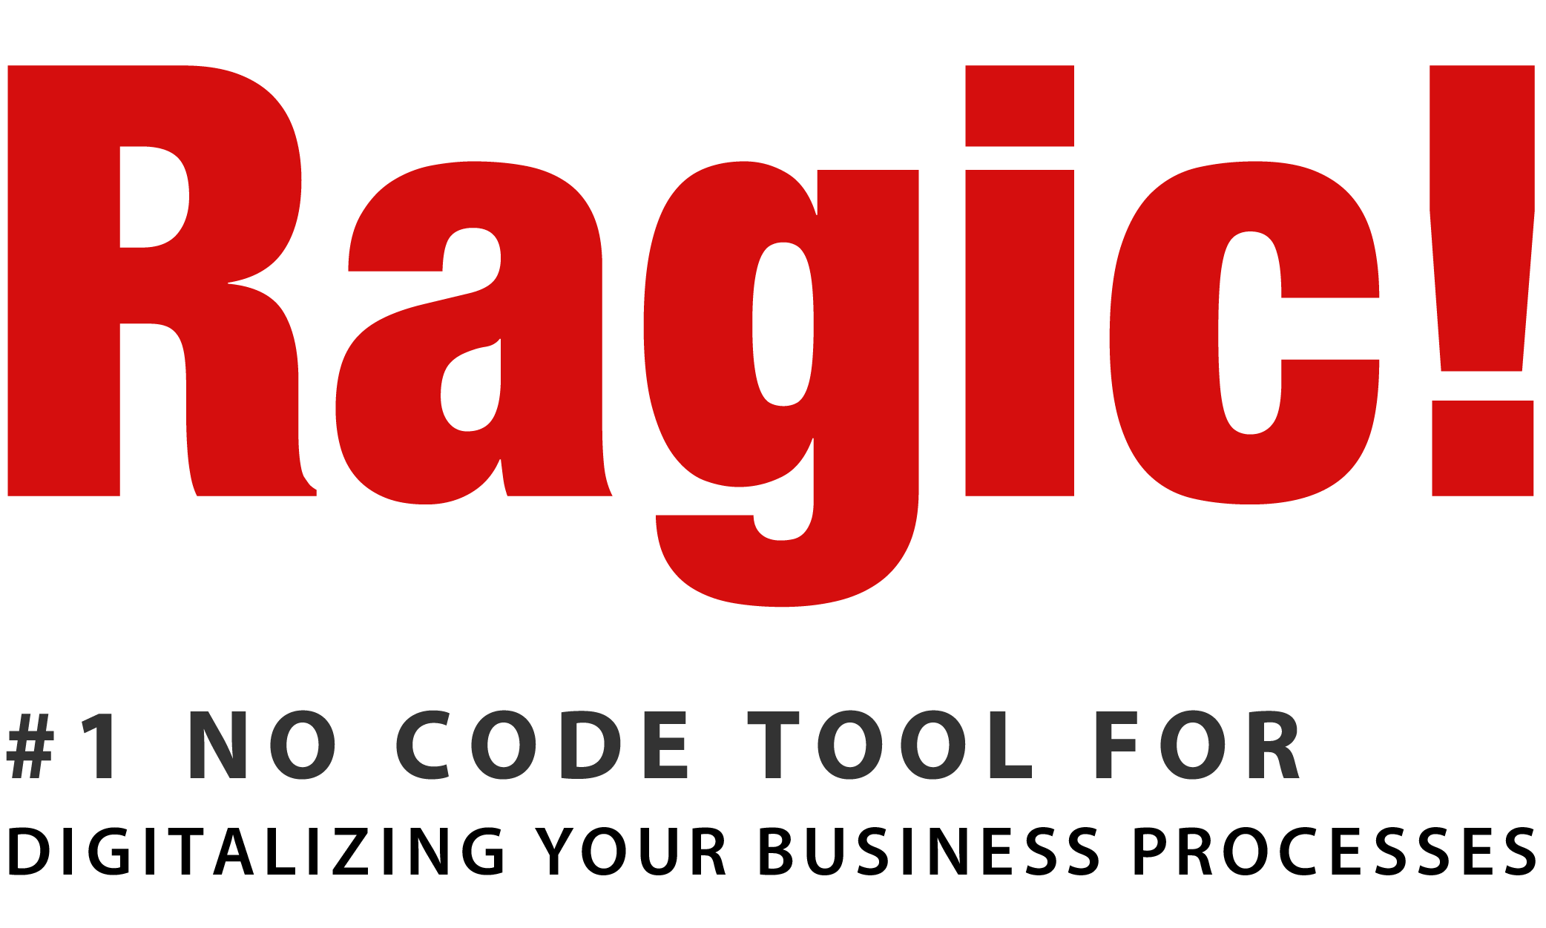

Slide 2
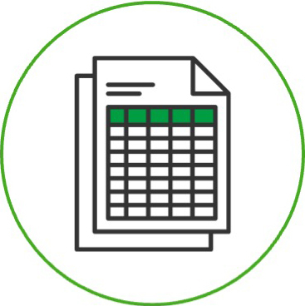
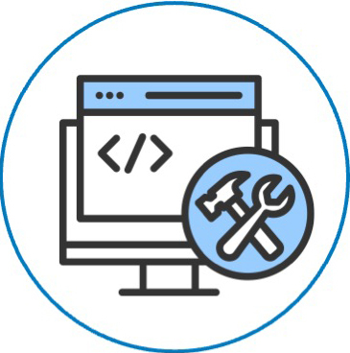

Existing Pain Points
Still using Excel?
Develop from scratch?
Software package?

Slide 3
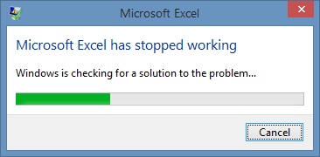
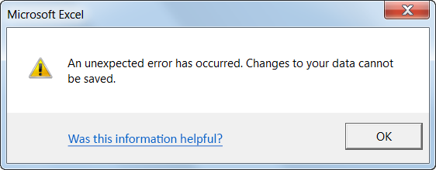



Still using Excel?
Merging versions
Locating errors
Finding the right info

Slide 4
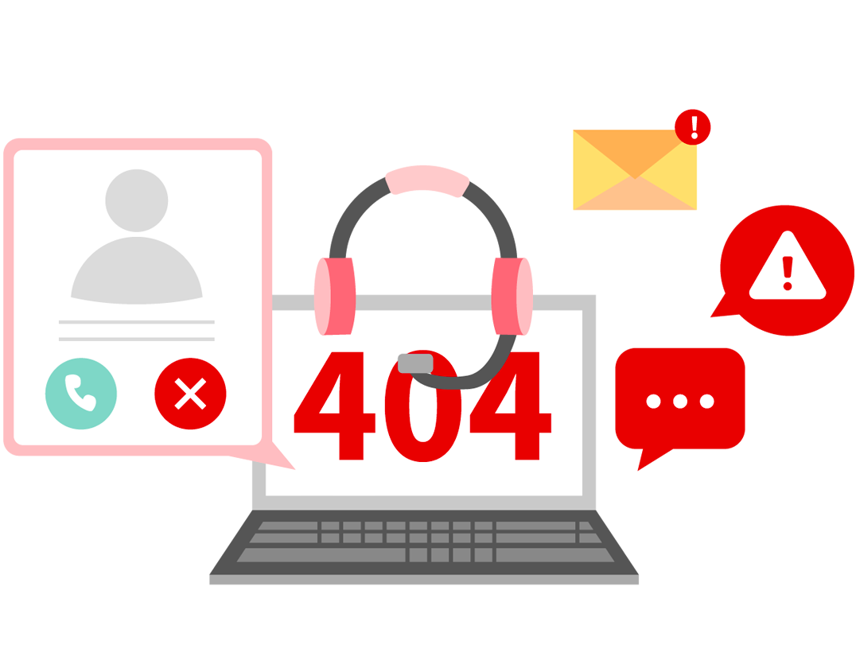
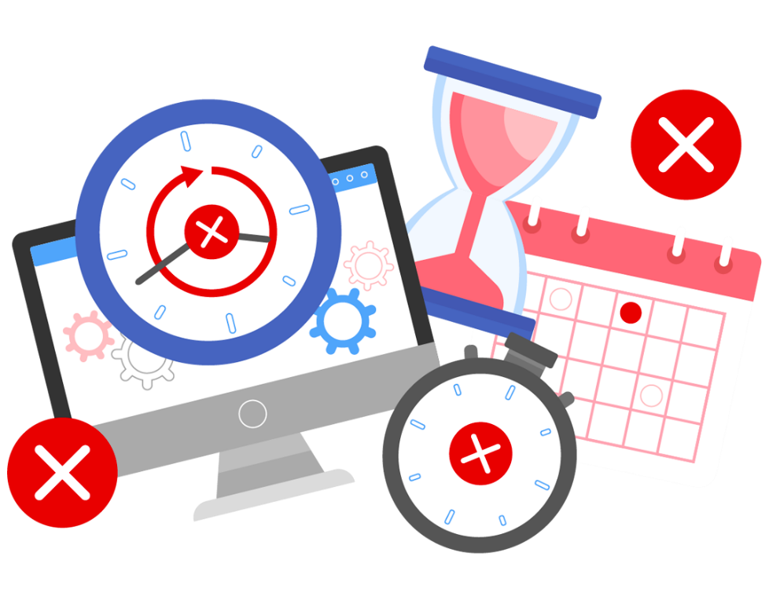
Develop from scratch?
Delayed or failed projects
Maintenance struggles
Wasted tons of time describing your business to your contractor, but you only ended up with a system that barely fits.
Is your contractor still answering your phone after 3 years? How about 10 years?

Slide 5
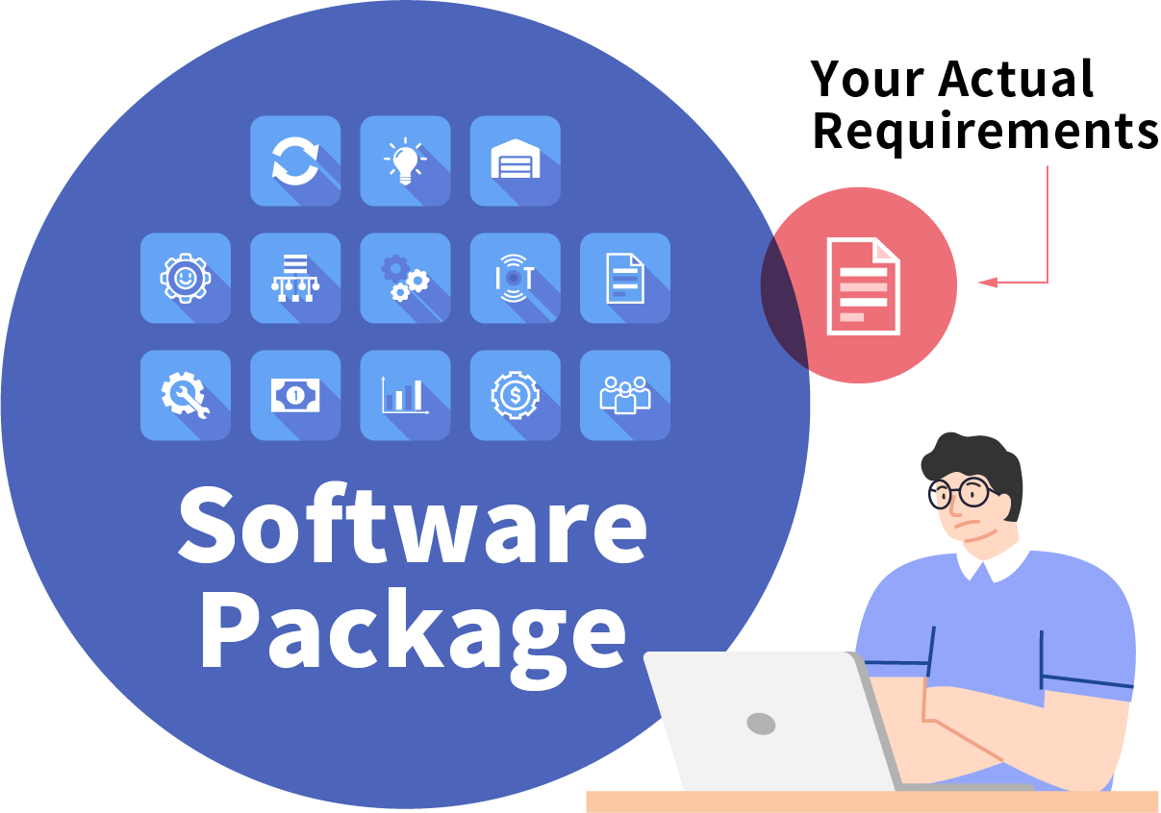
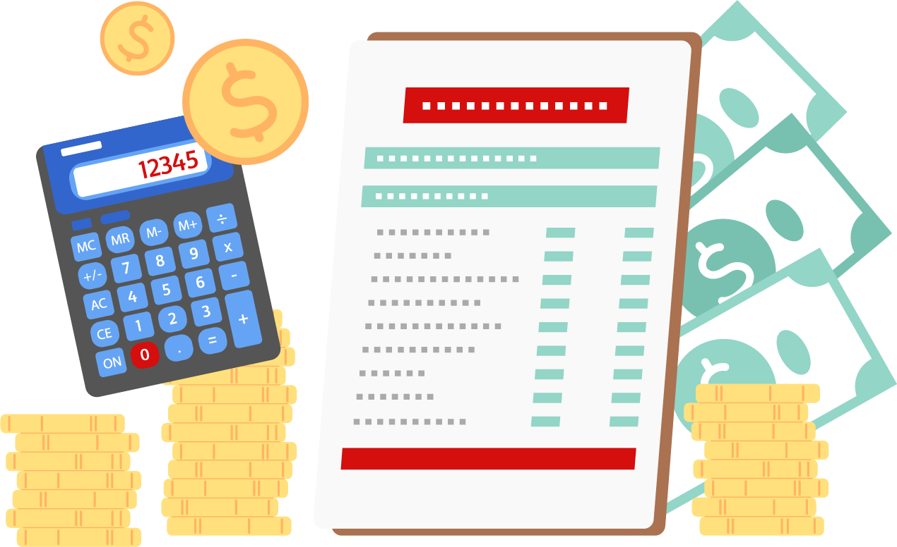
Software package?
Way too big
Large hidden costs
A software package has a lot of functions, but it doesn't really meet your actual requirements.
Additional customizations are needed to meet business requirements, which will cost much more than expected.

Slide 6
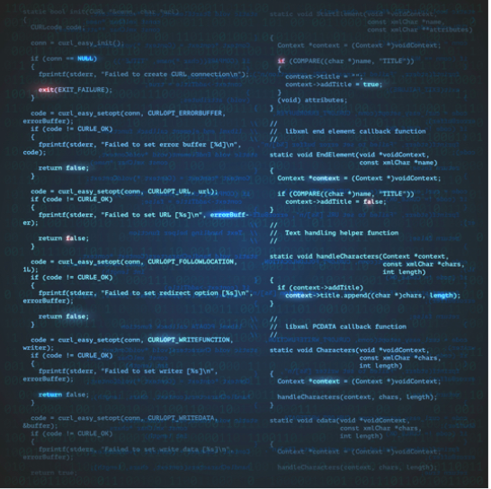
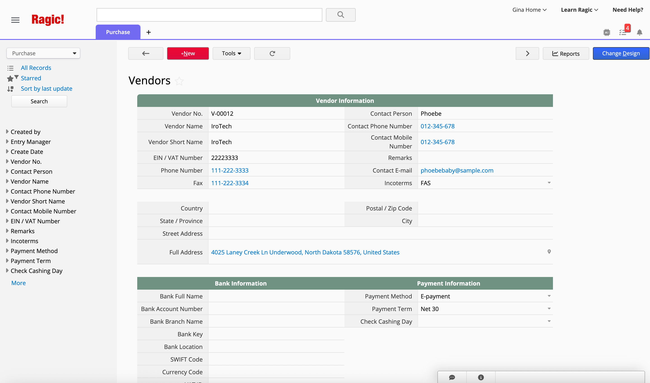

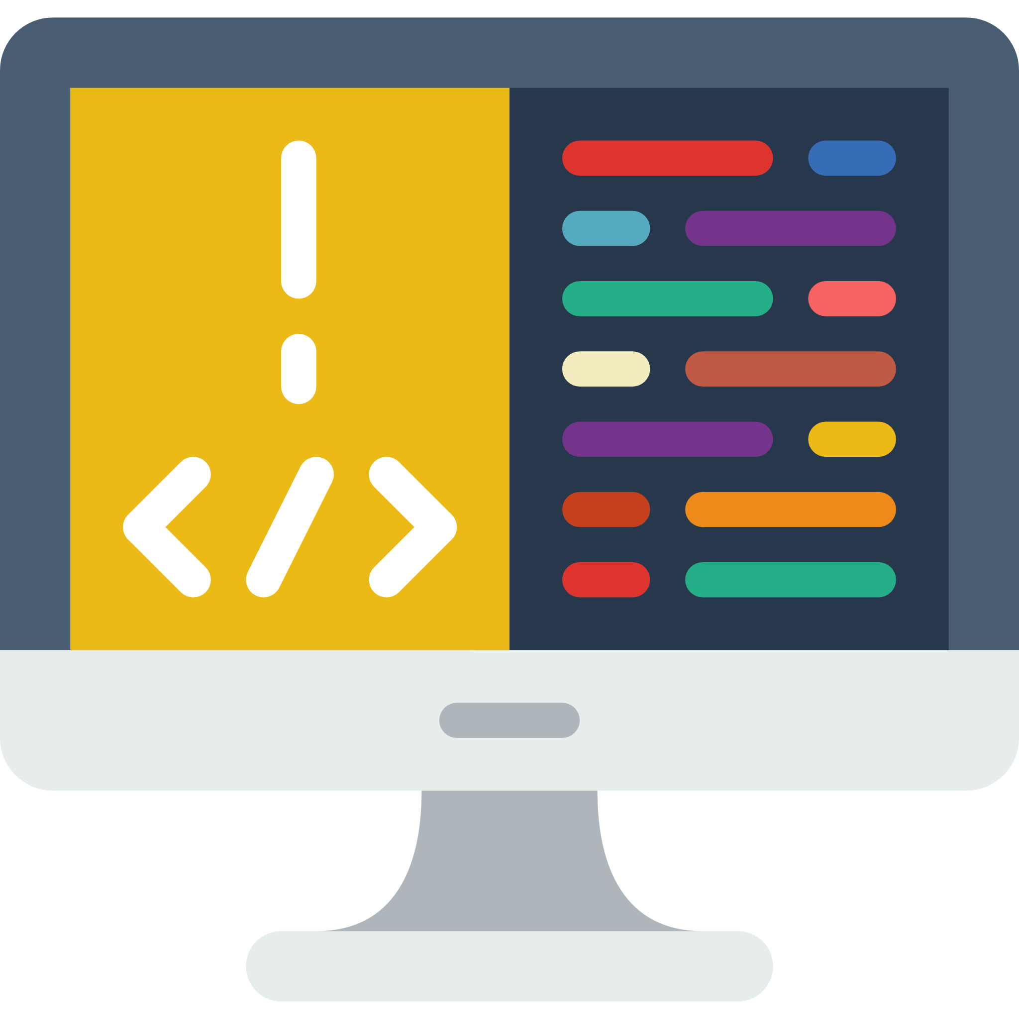
is here to solve this
Traditional Database Development:
No-code Database:

Slide 7
What makes different?

Slide 8
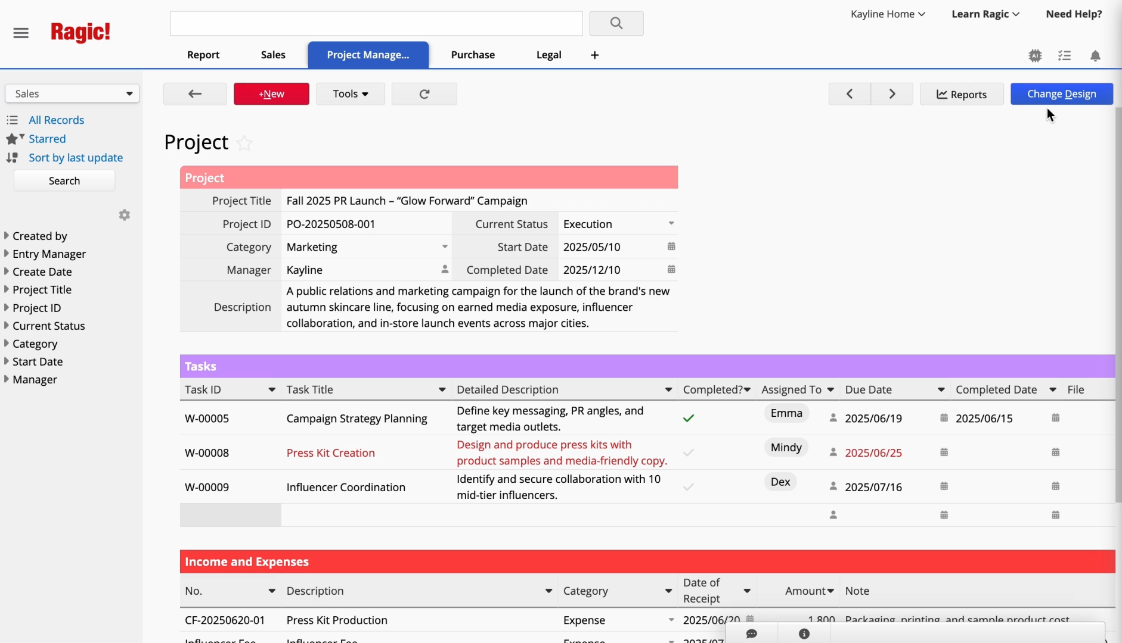
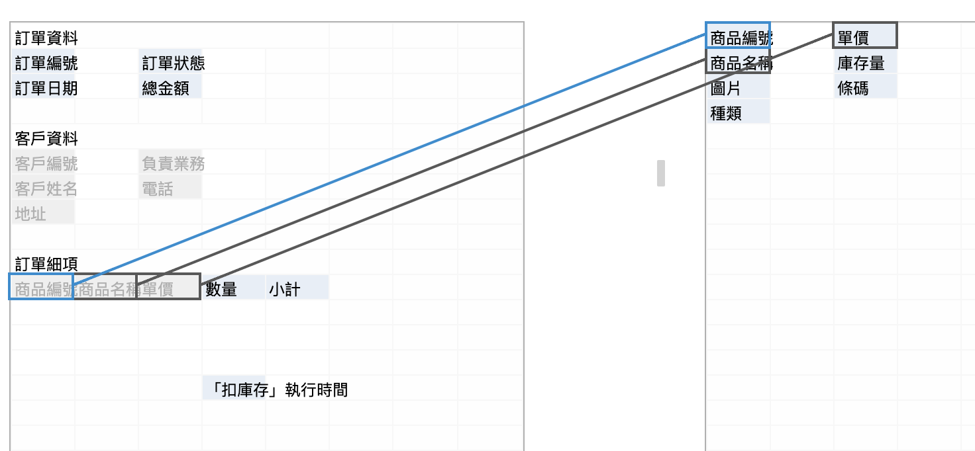
Customization
Instant design adjustments, without a line of code
✓
Relationship between sheets
✓
Instant design adjustments
✓
Add and modify features

Slide 9
Integration
A single database system that manages all your workflows
Sales Order
Inventory
CRM
Marketing
Reports
HR
Approval
Customer Support
Project Management
File Management

Slide 10
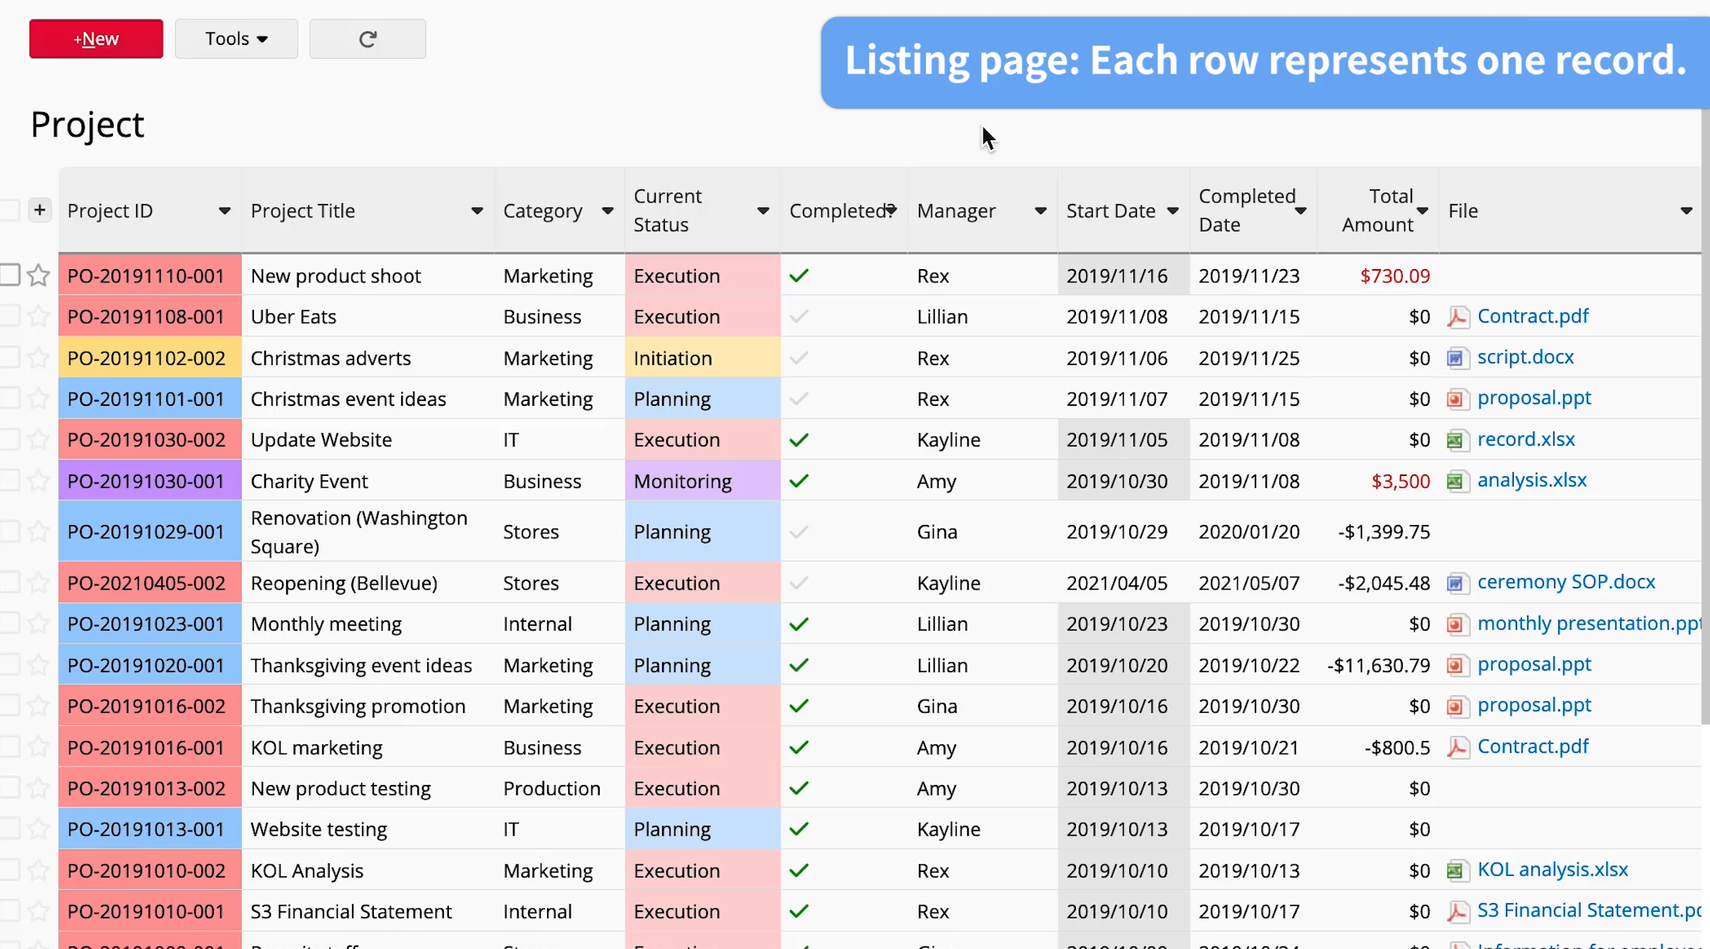
Simple
We keep database design simple,
make it as easy as creating a form on a spreadsheet

Slide 11
Powerful features
Your no-code database comes with these powerful features!

Slide 12
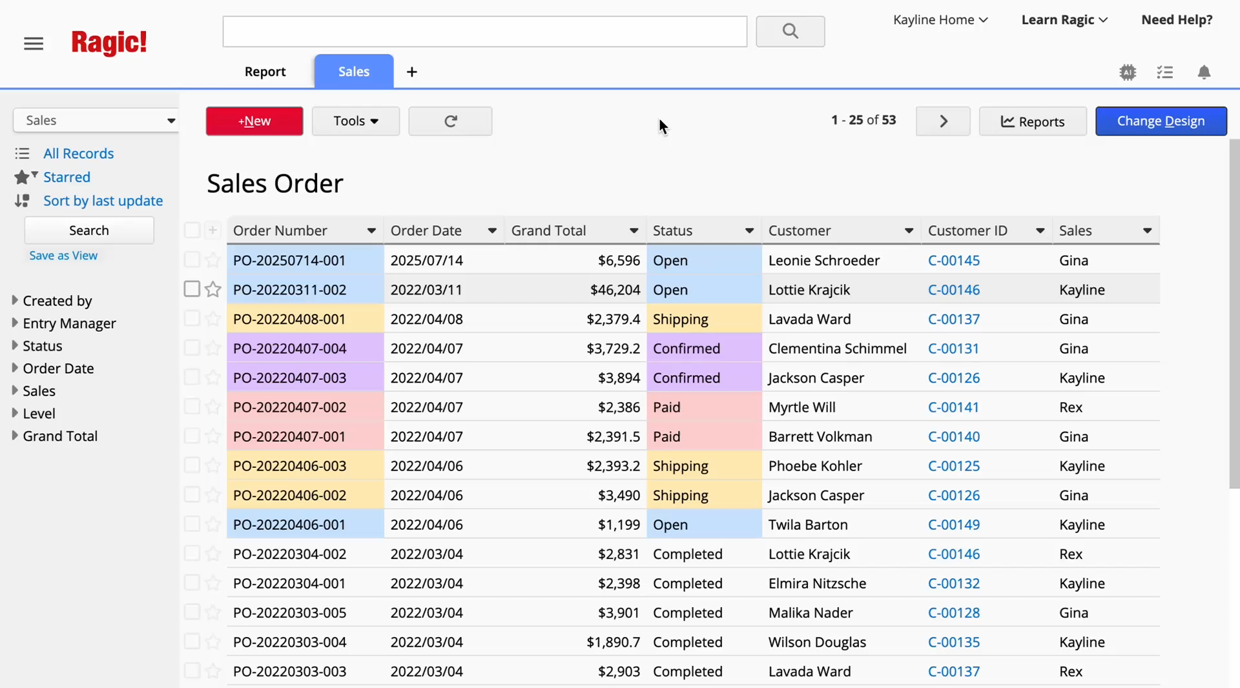
Full-Text Search
The confidence of instantly finding the data you are looking for

Slide 13
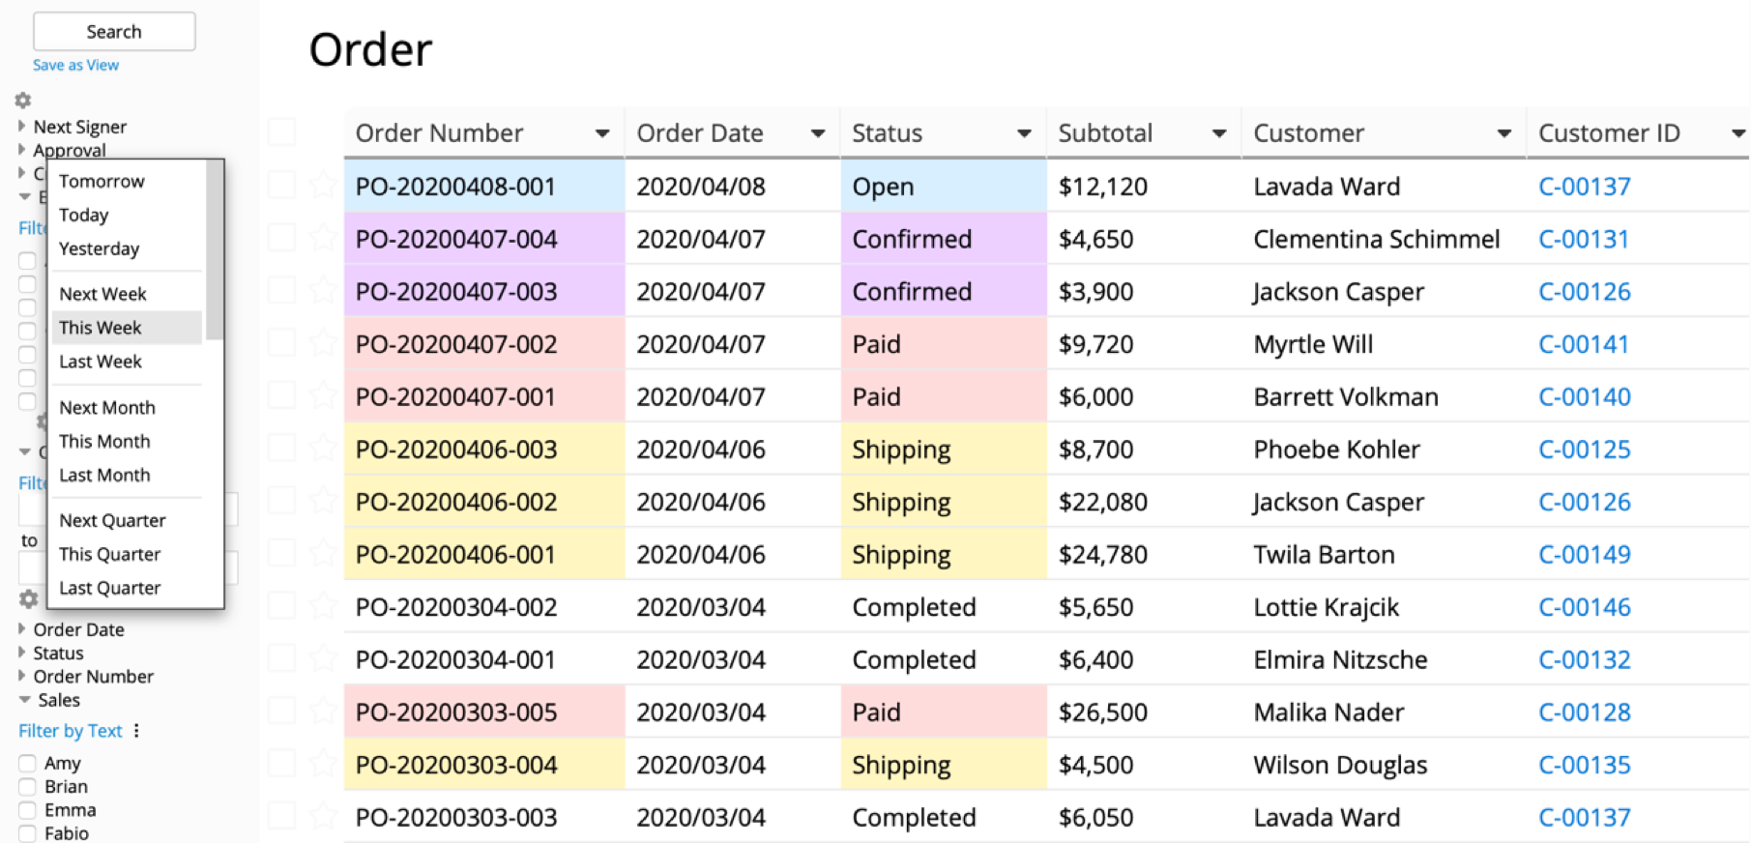
Query Builder and Data Views
Create multiple views based on query criteria using any combination of fields

Slide 14
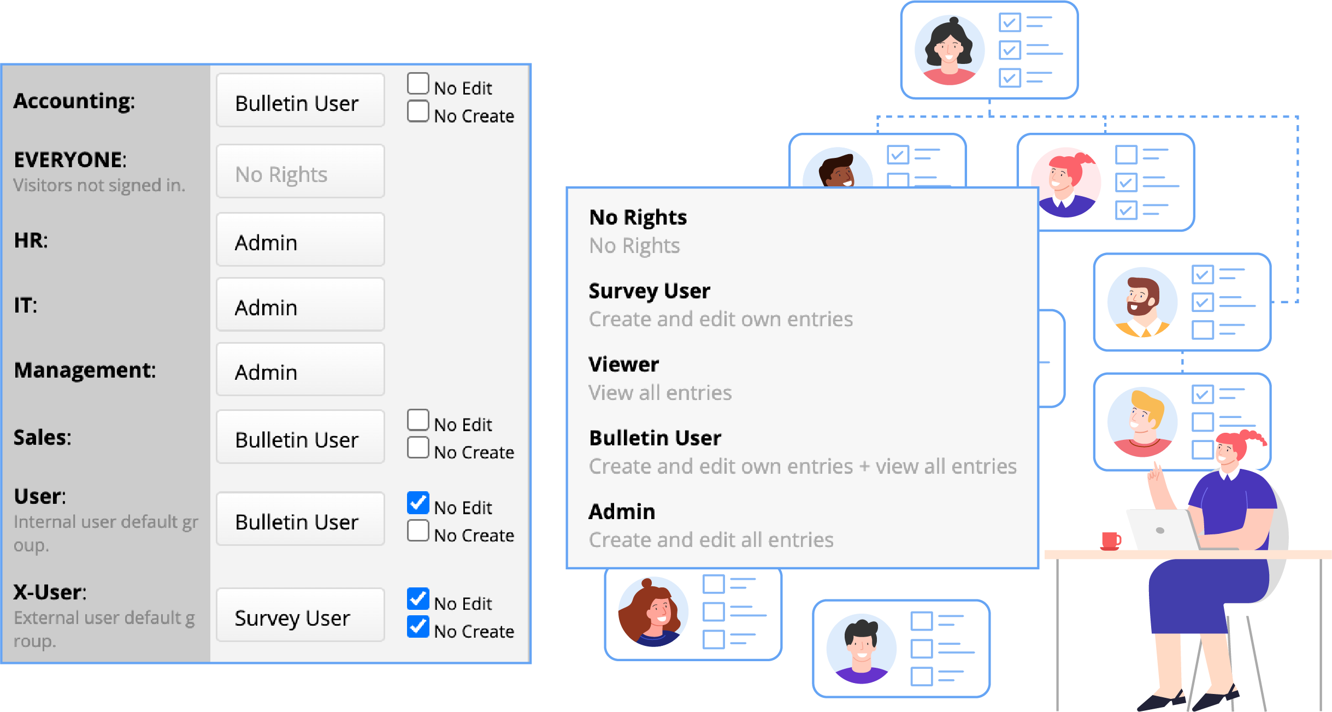
Controlled Access
Covers all complex access management scenarios to control who can view or modify specific data

Slide 15
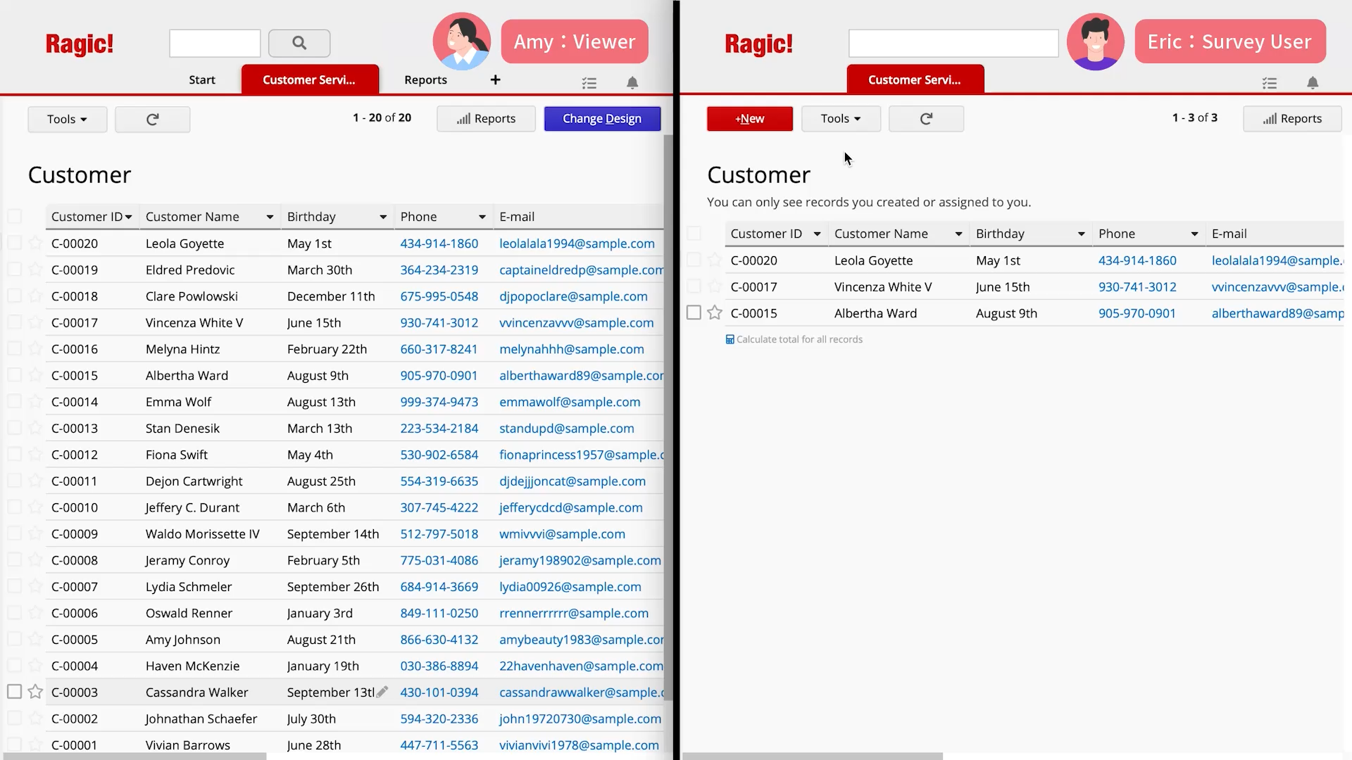
Viewer vs. Survey User

Slide 16
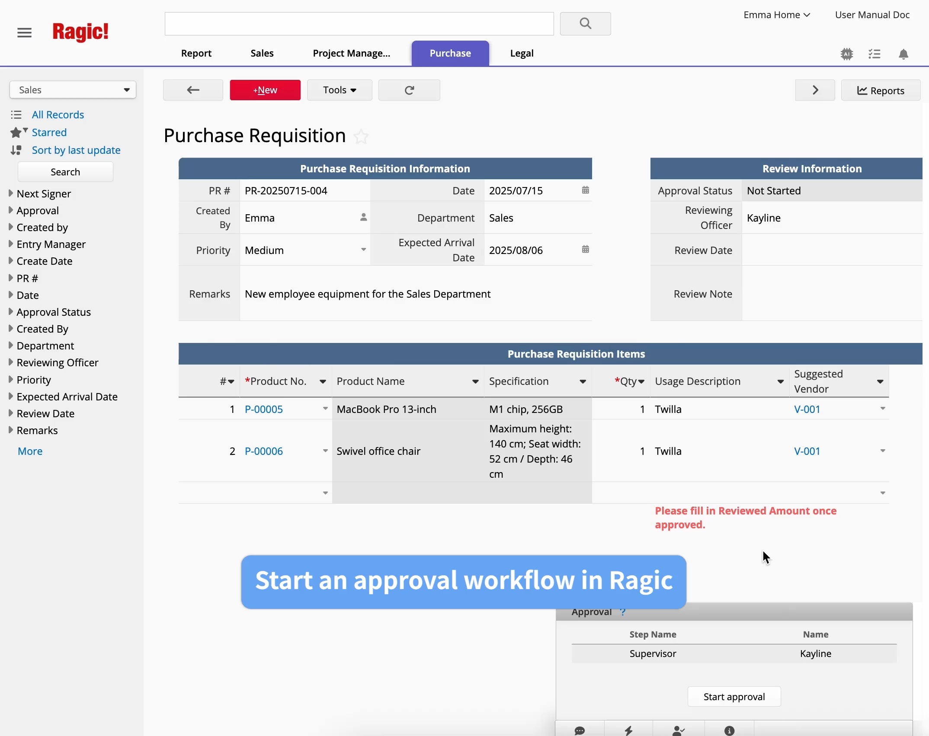
Approval Workflow
One-click approval process through Ragic’s database, email, or Ragic App, with the ability to adapt your approval workflow by setting up rules

Slide 17
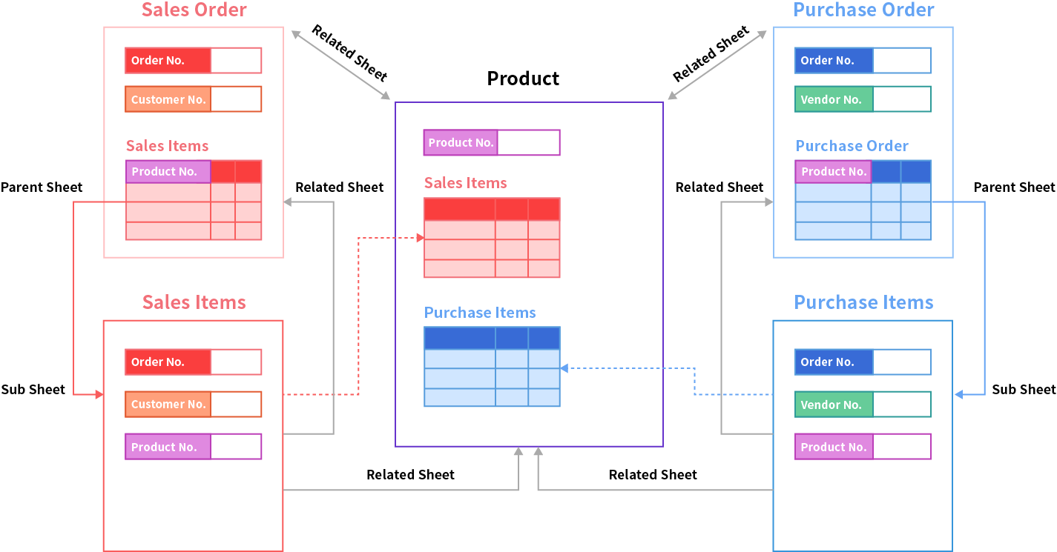
Cross-Sheets Relationships
Handle one-to-many relationships in Ragic
with automated data retrieval and calculation

Slide 18
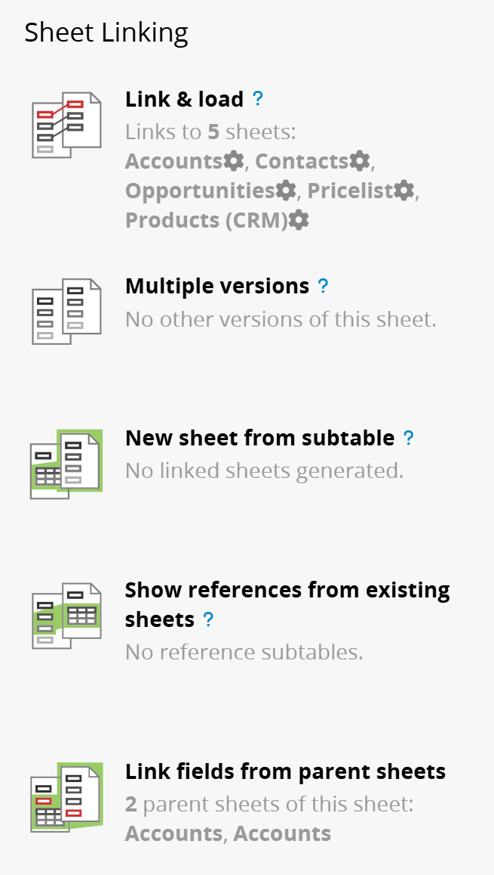
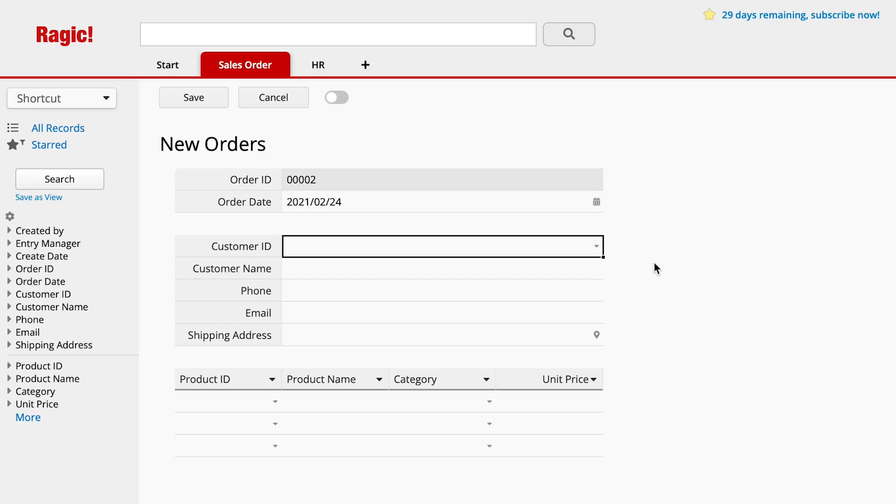
Link and Load
Significantly reduces data entry time and prevents manual input errors

Slide 19
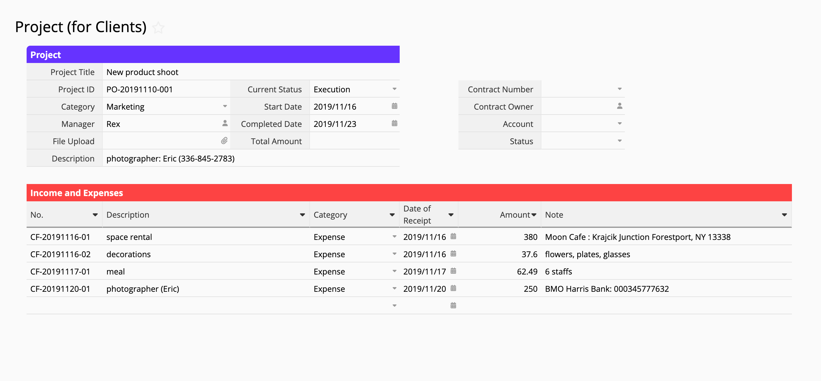
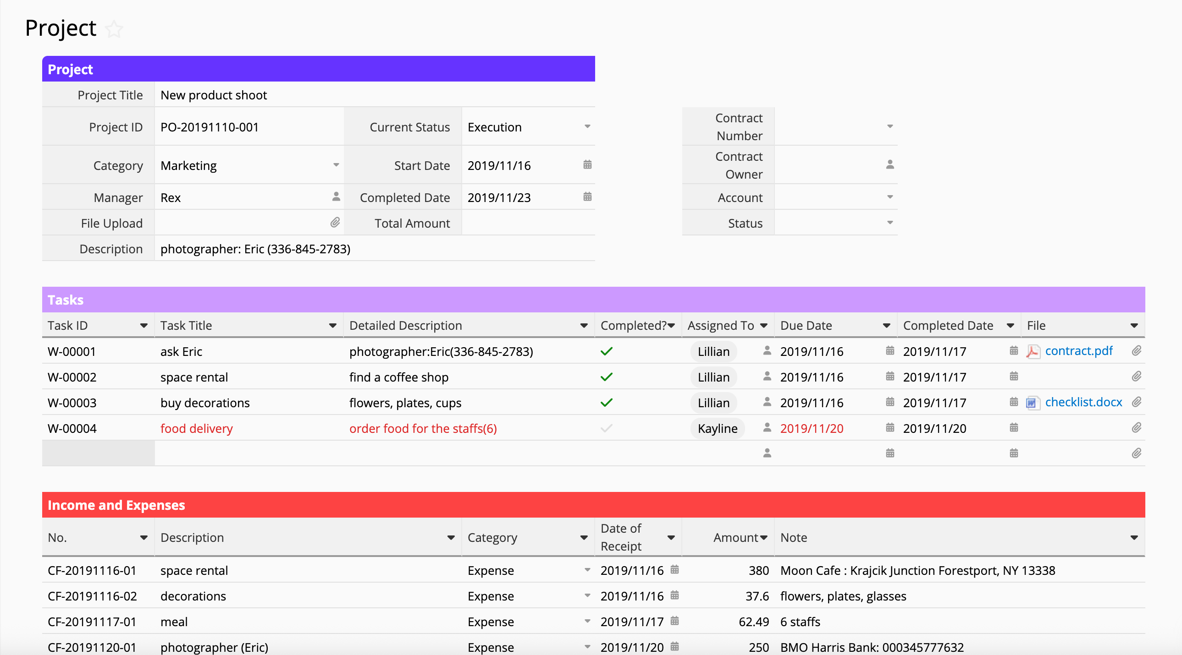
Multiple Version Sheets
The same sheet can be created in multiple versions to display different information
Client use
Internal use
Design different fields for client/internal forms
— updates sync automatically!

Slide 20

Reports
Crystal-clear visualization of your data with auto-generated reports

Slide 21
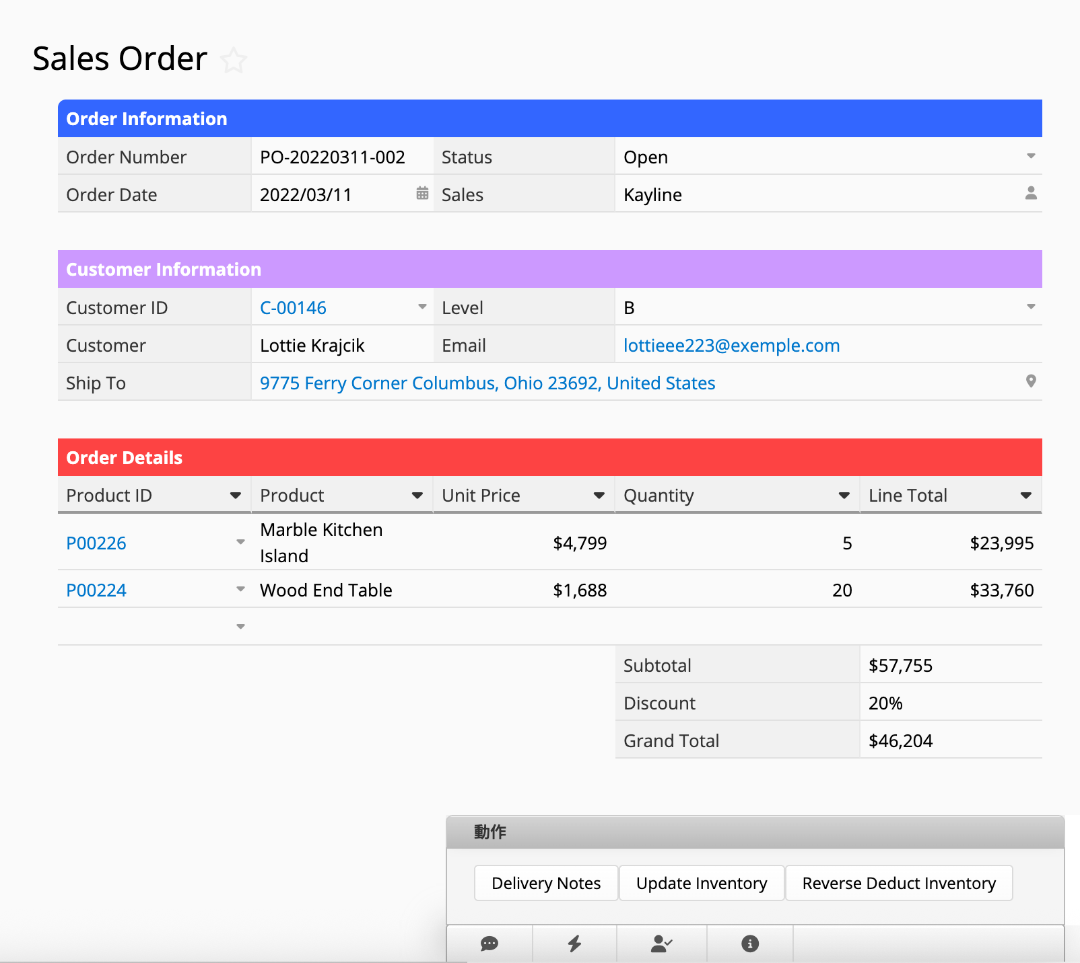
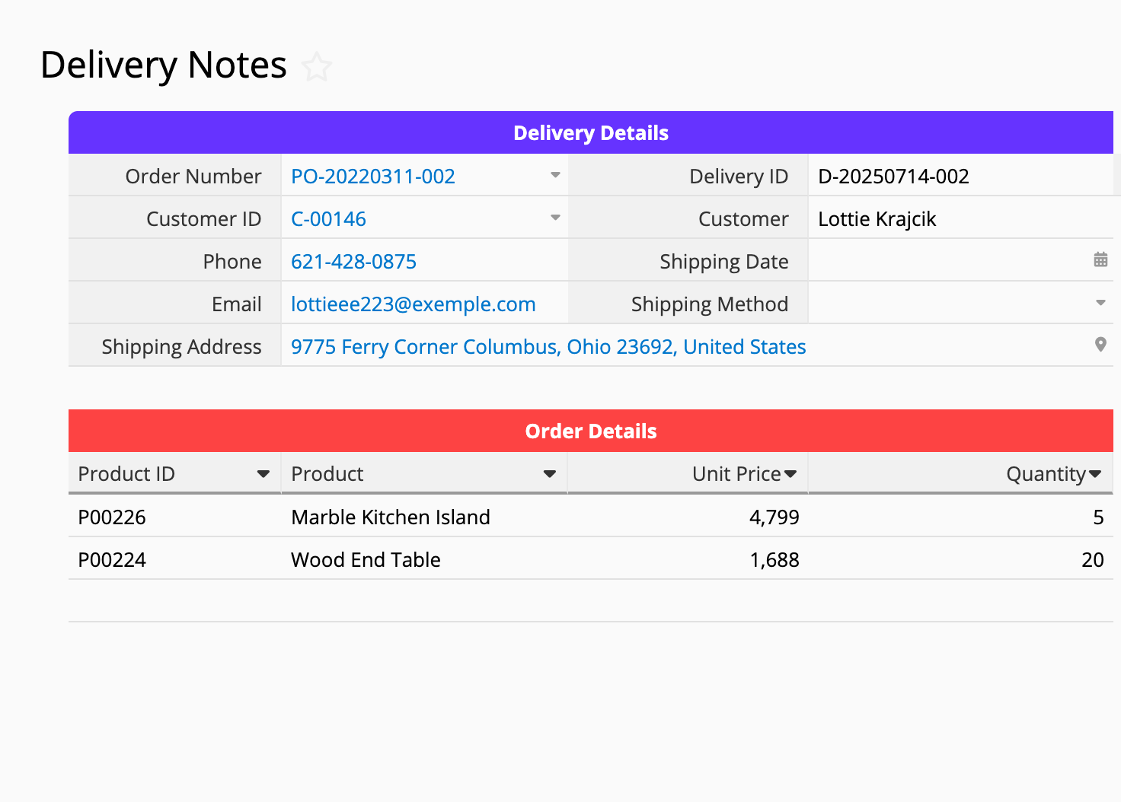
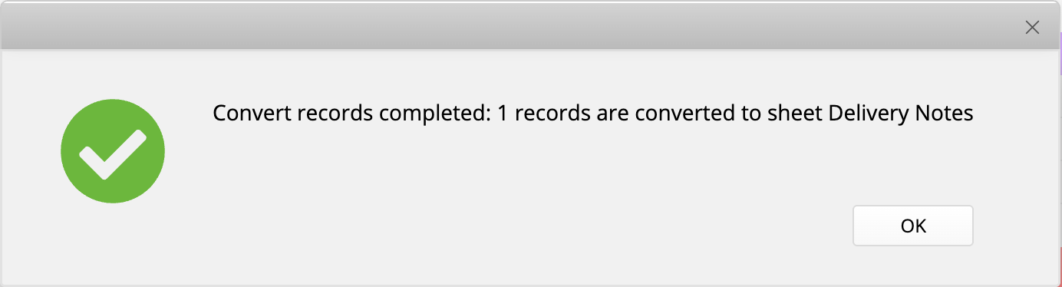
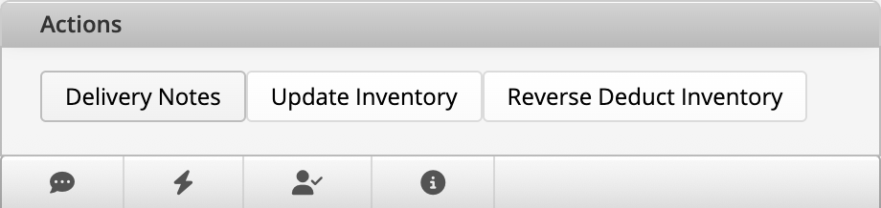
Action Buttons: Convert Records
Convert a sales order into a delivery note

Slide 22
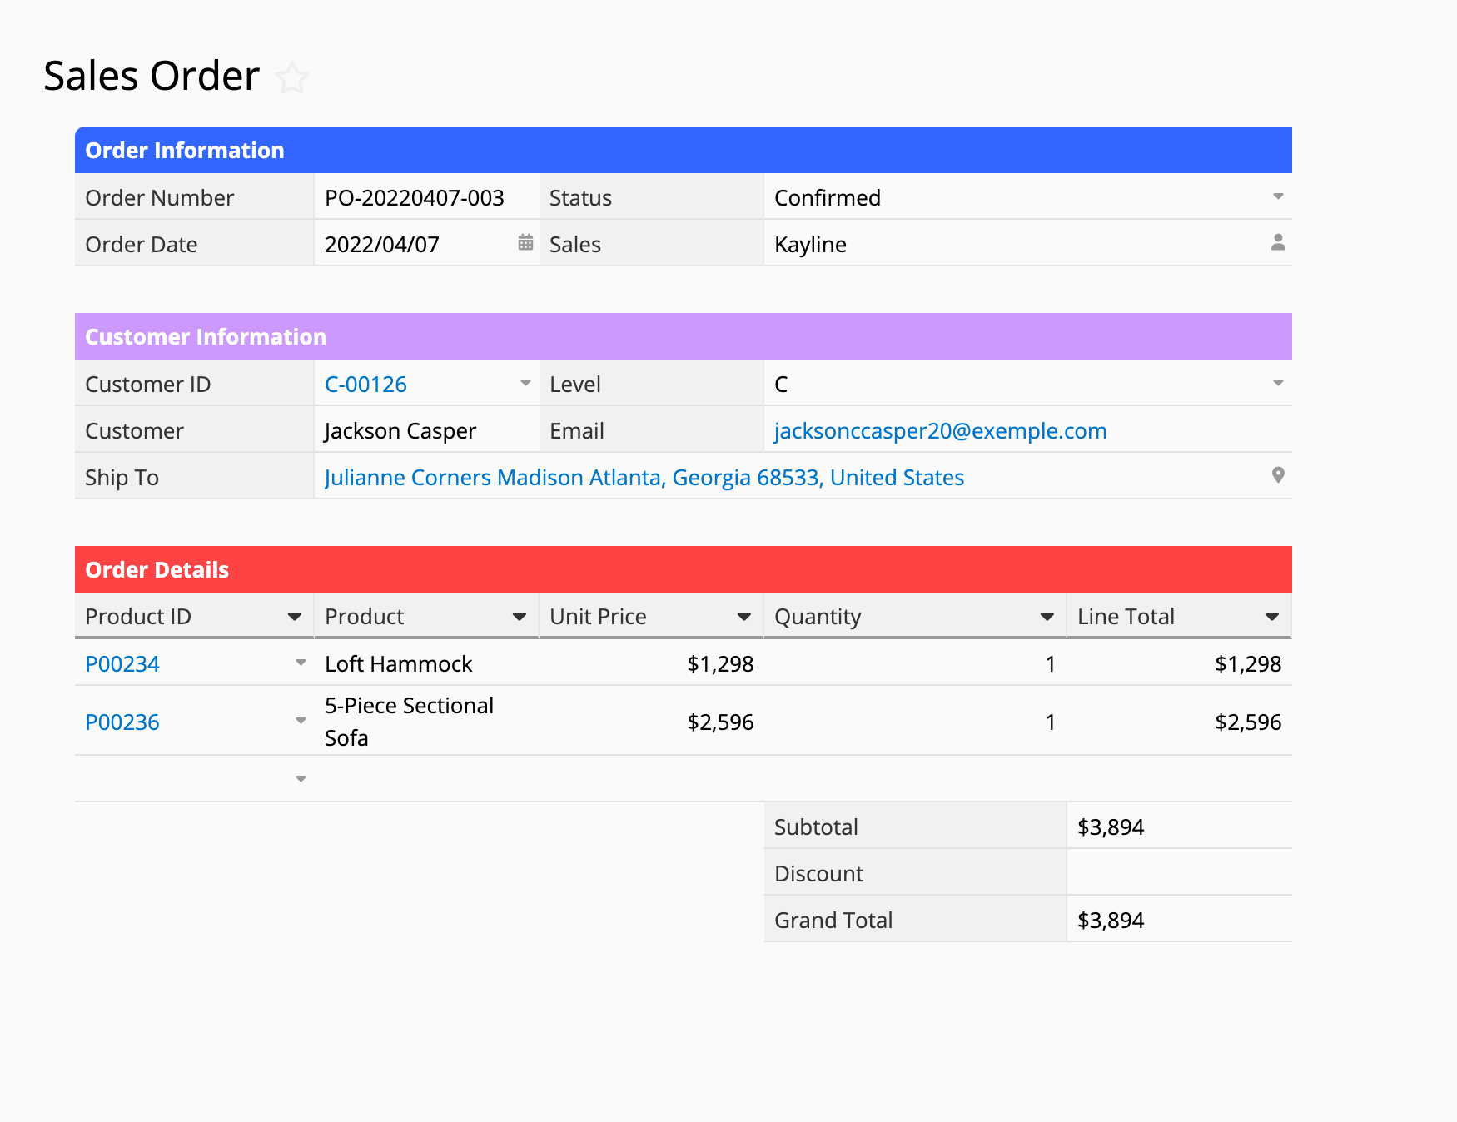
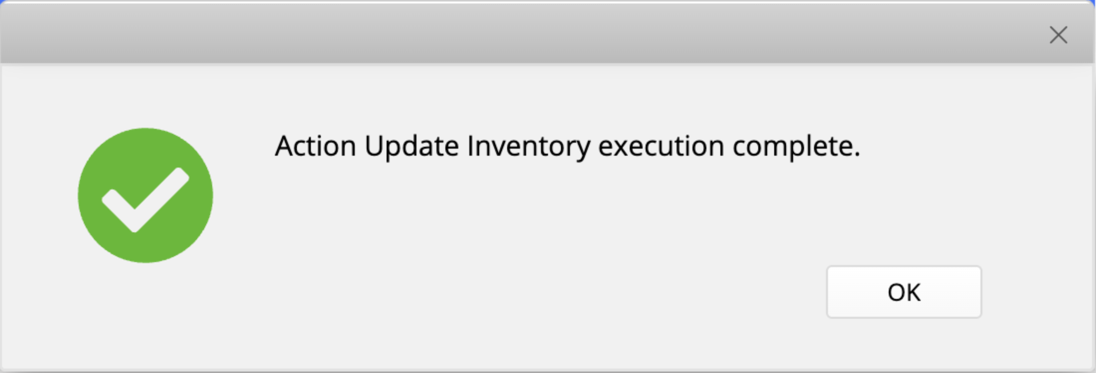
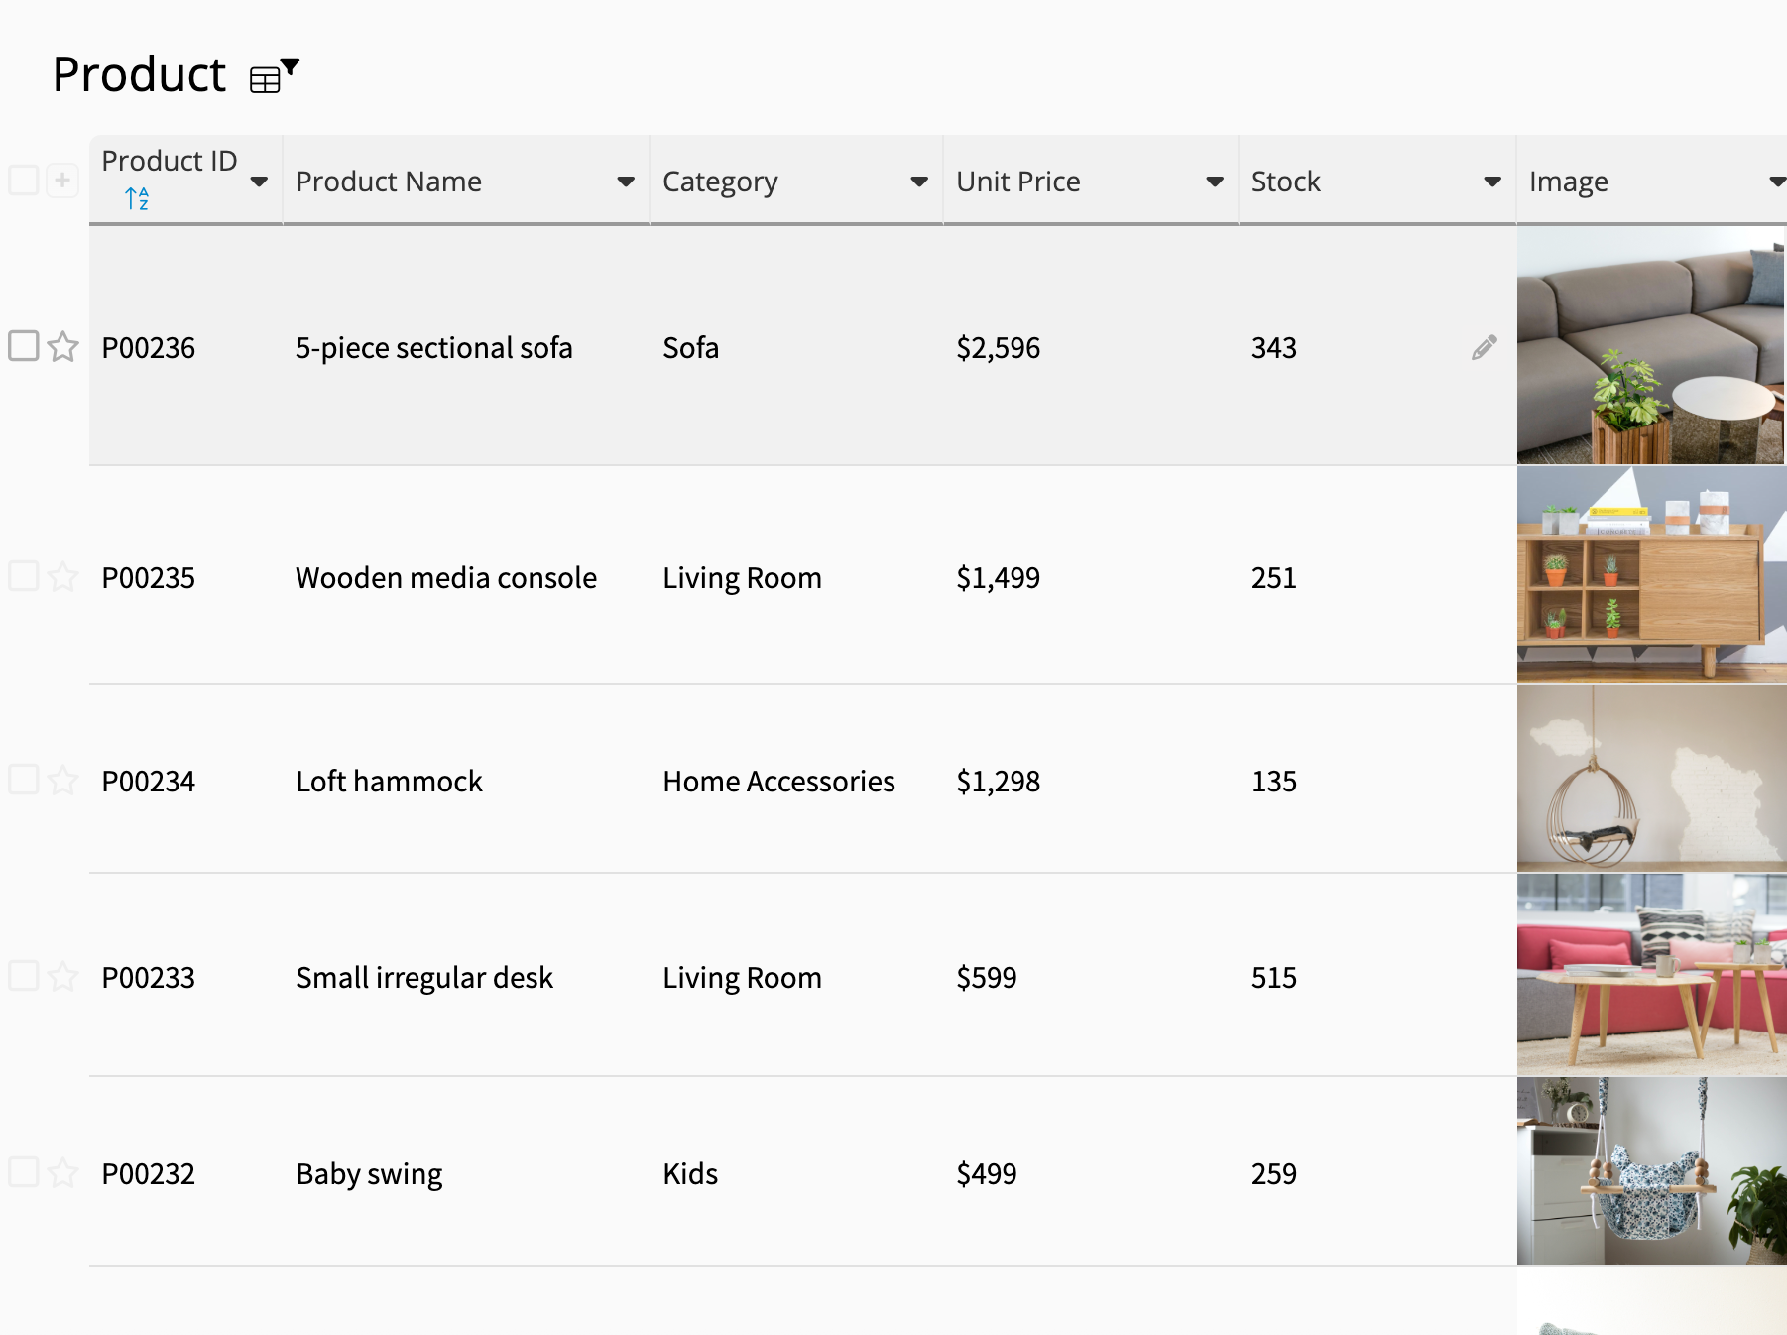
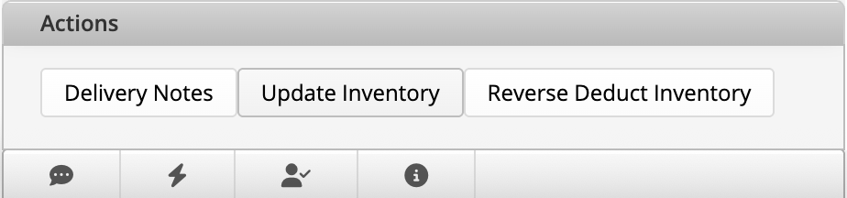
Action Buttons: Update Values
Update the inventory balance with one click

Slide 23
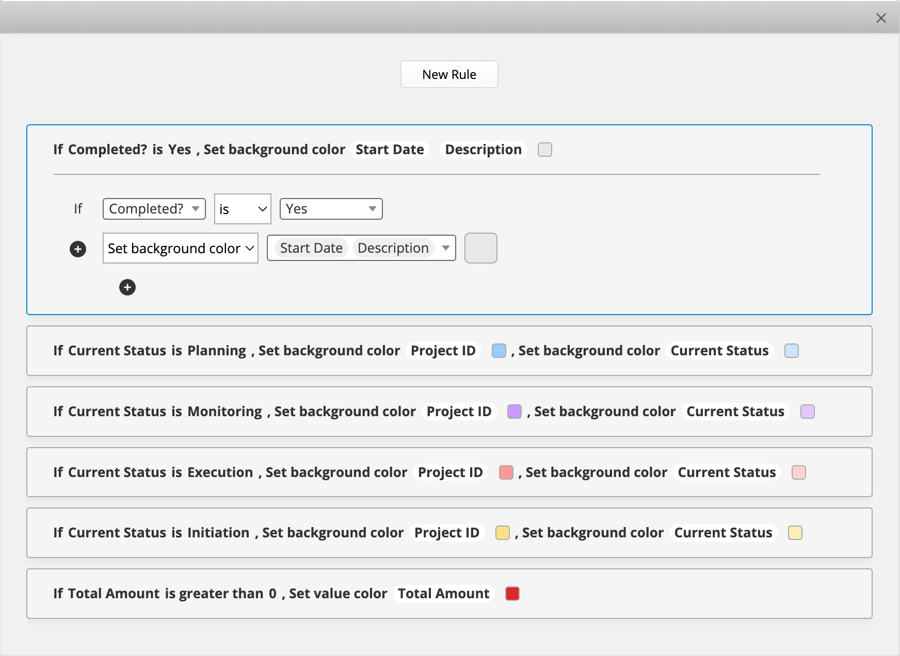
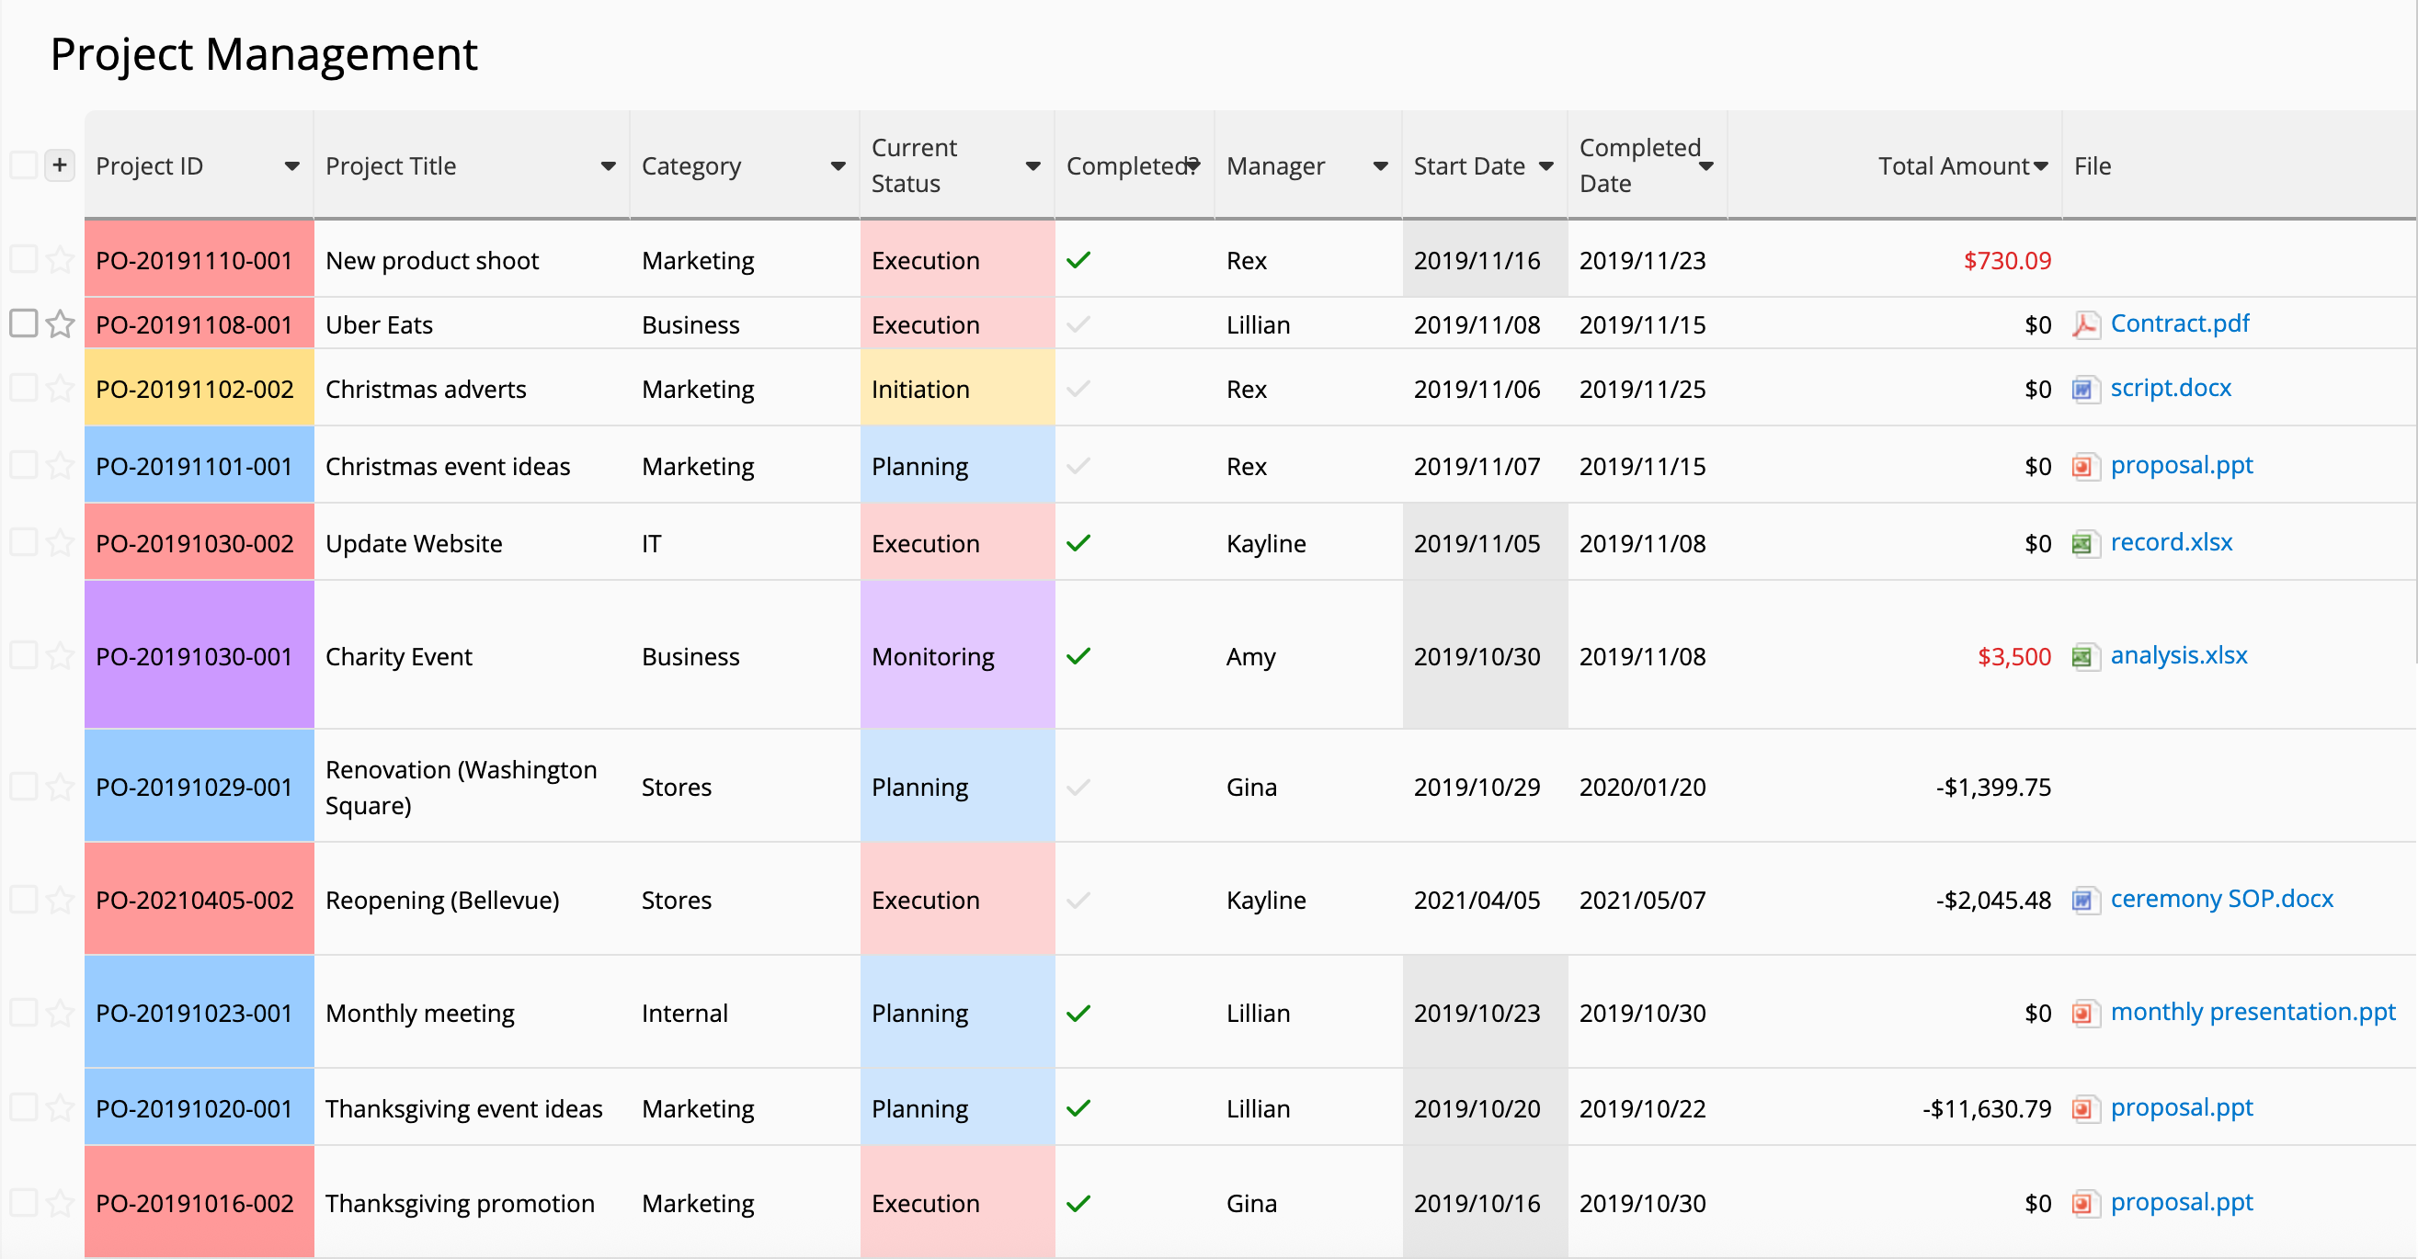
Conditional Formatting

Slide 24
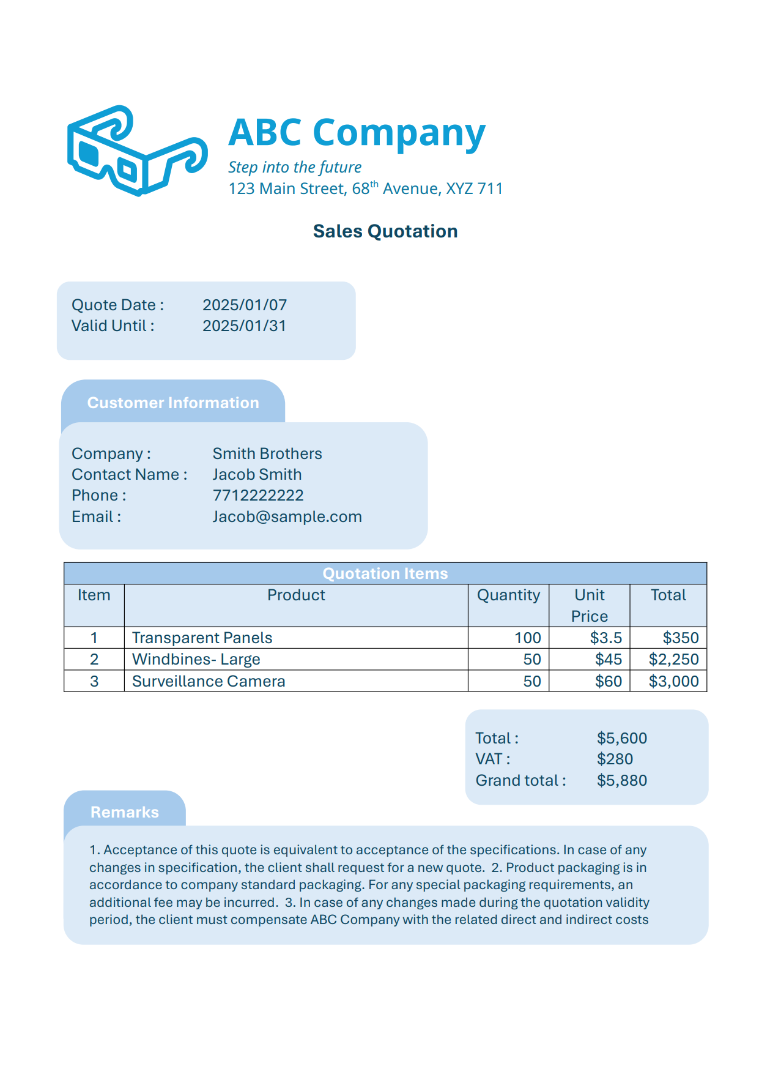
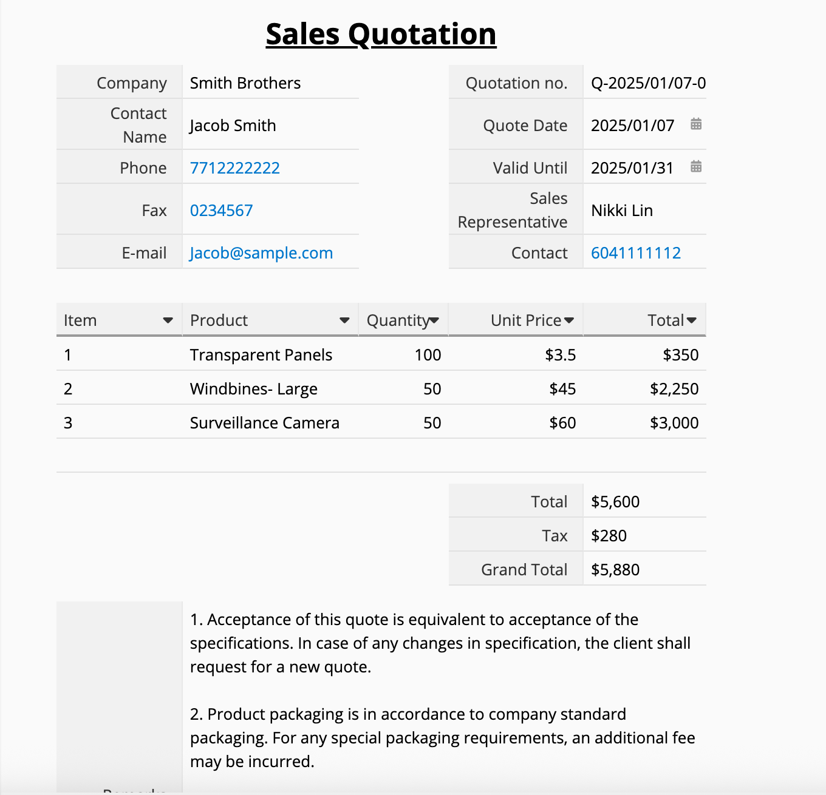
Custom Print Report
Sales Quotation.pdf

Slide 25
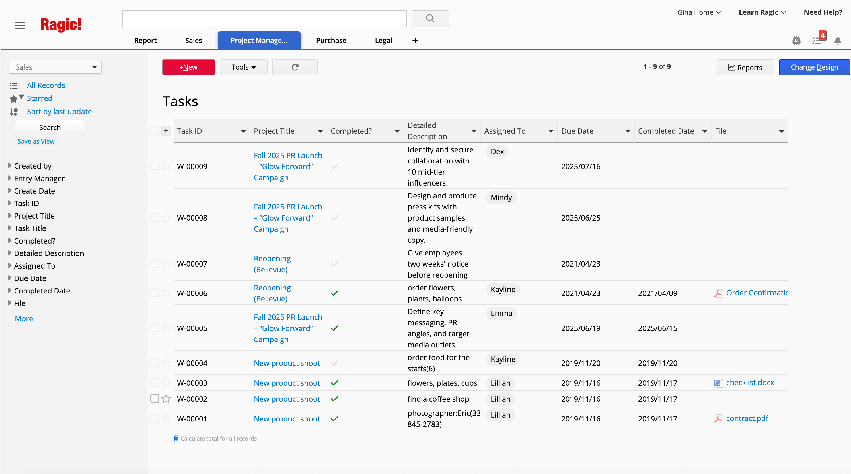
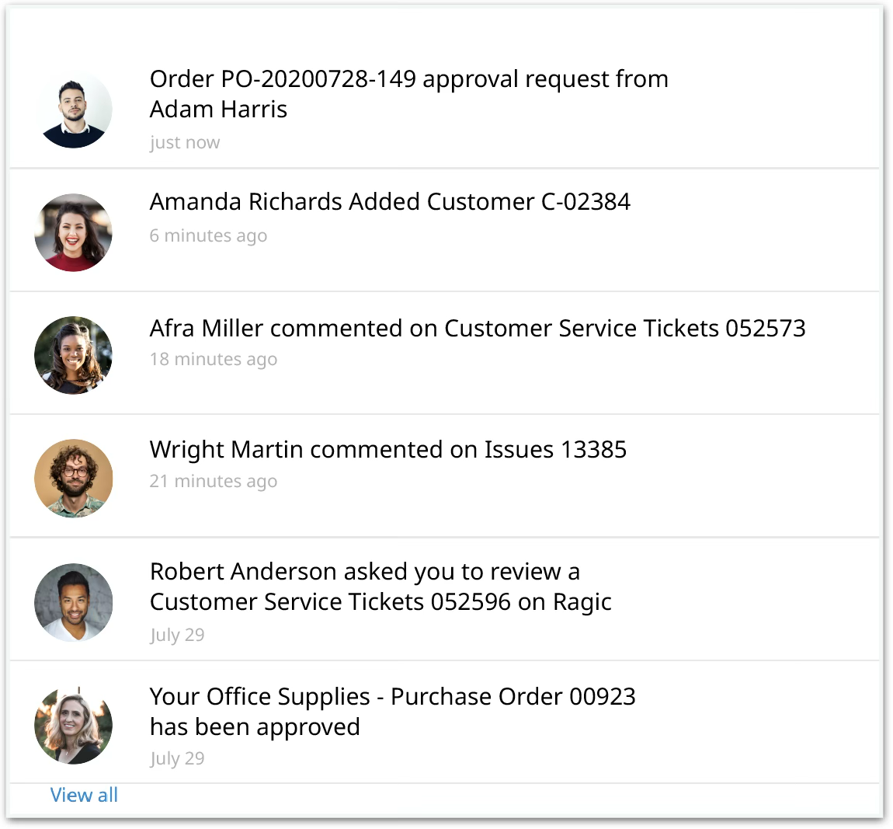
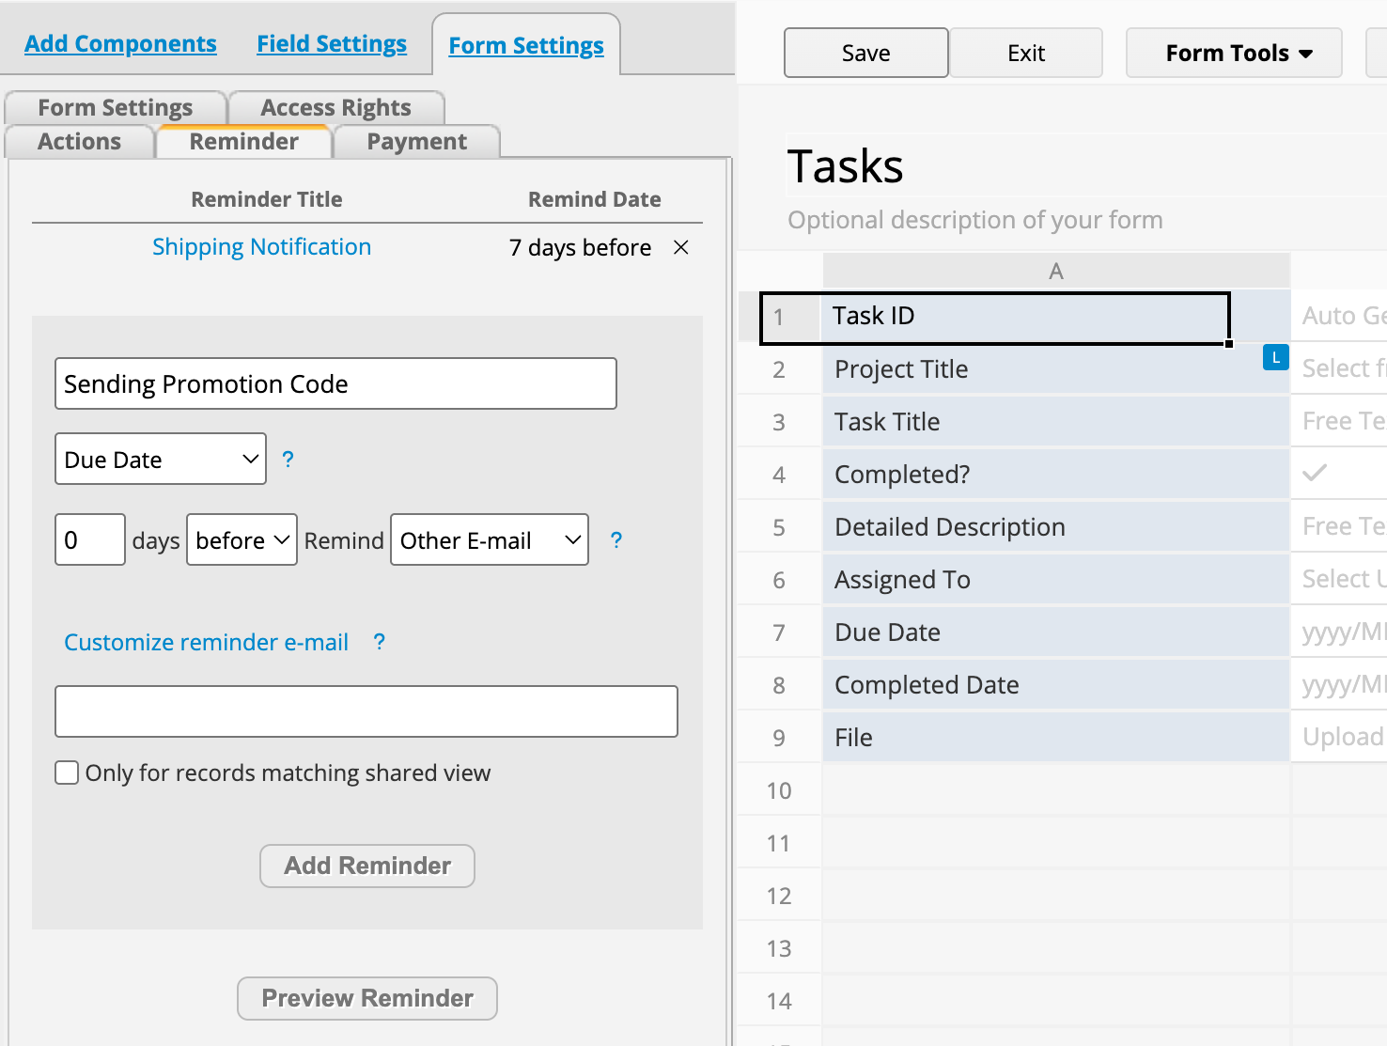
Reminders & Instant Notifications
Get the latest updates via email, on-screen reminders, and real-time alerts

Slide 26
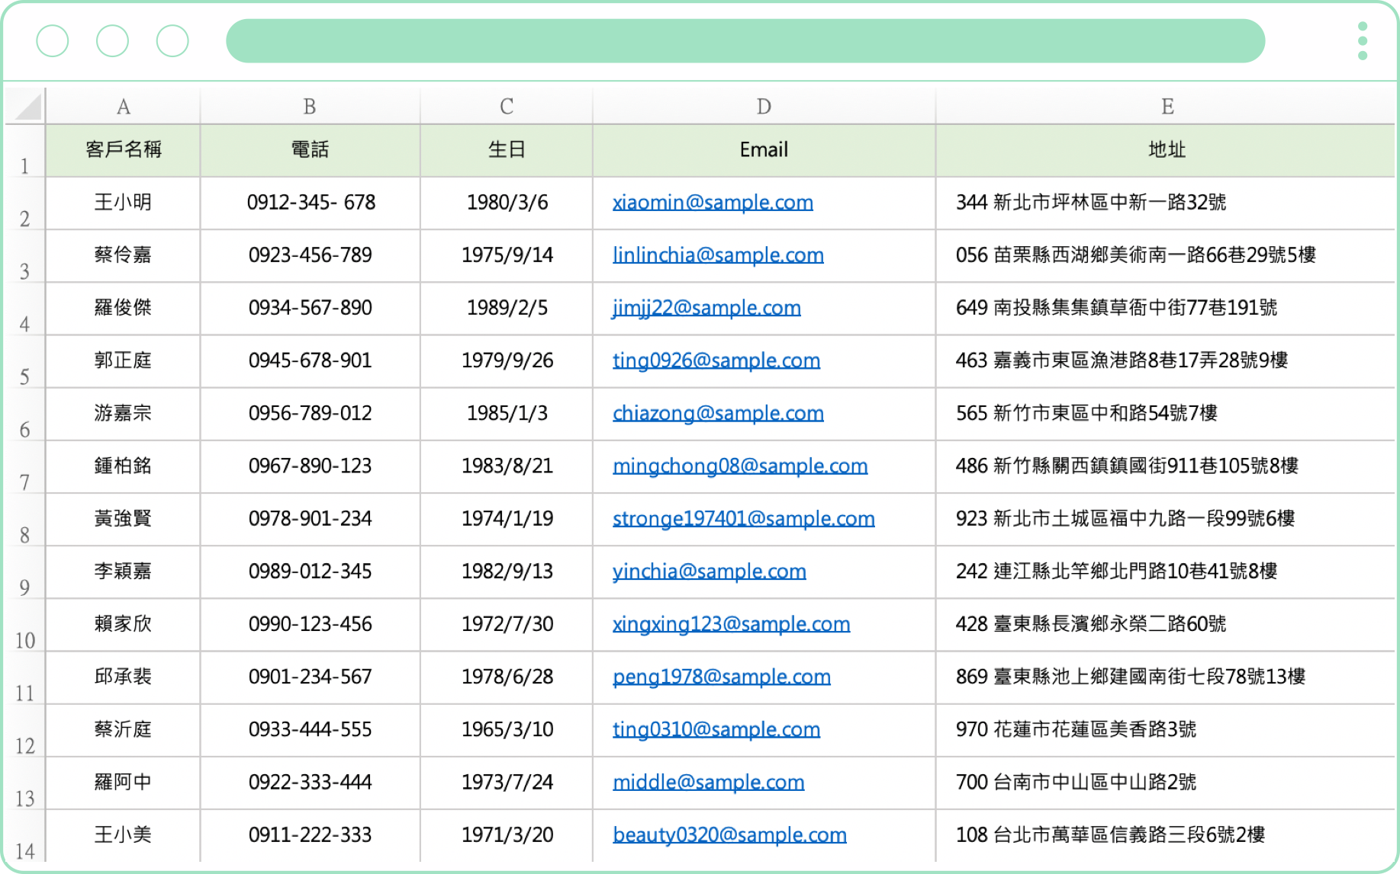
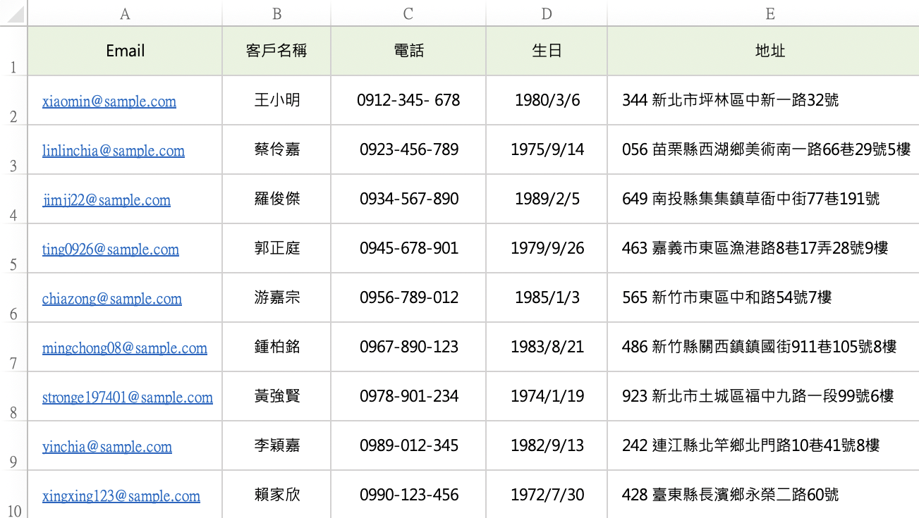
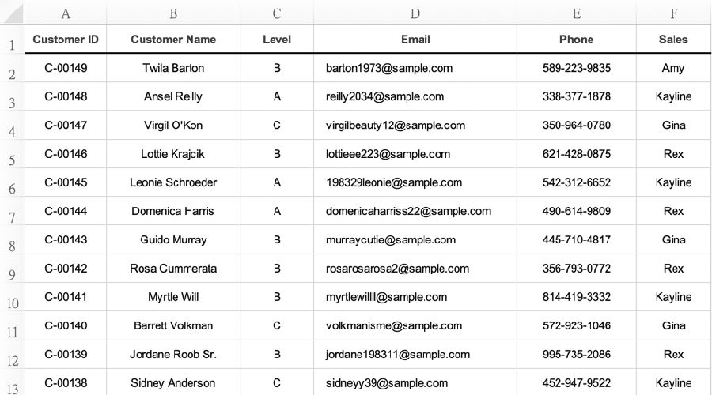
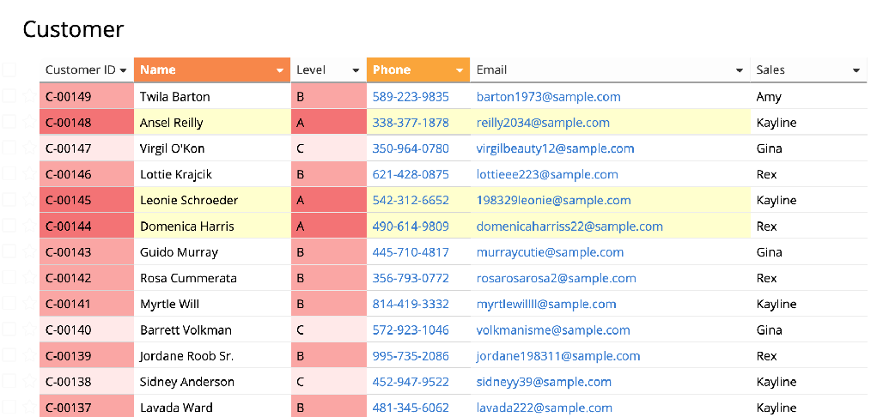
Importing and Exporting
Create databases with Excel files
Export Excel/CSV files

Slide 27
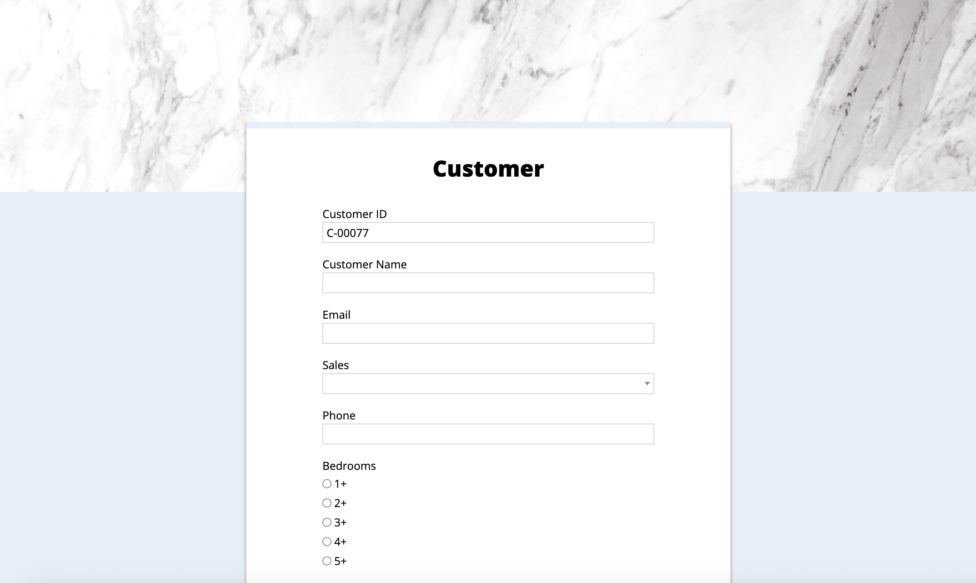
Embedding on Your Website
Integrate database functionalities to power your web pages and blogs

Slide 28
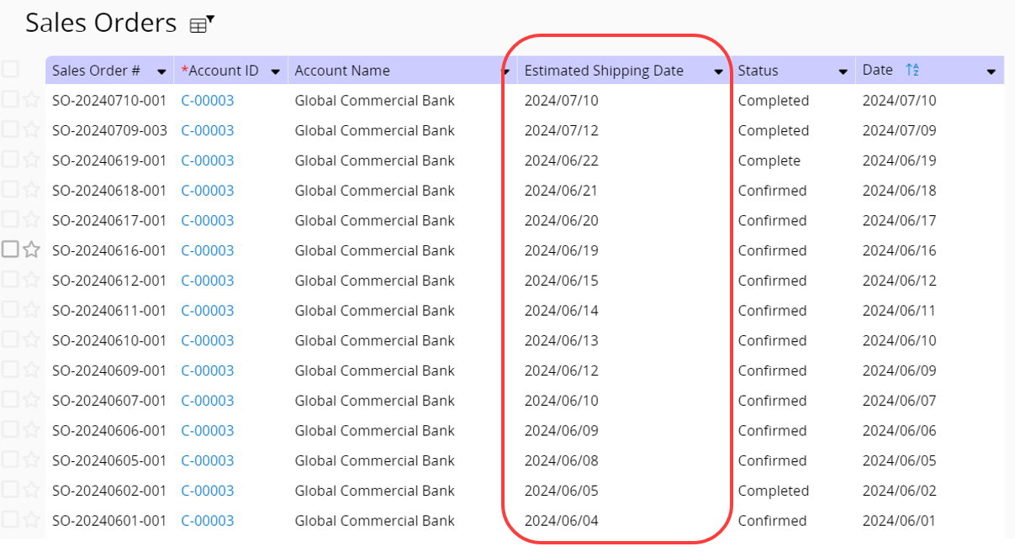
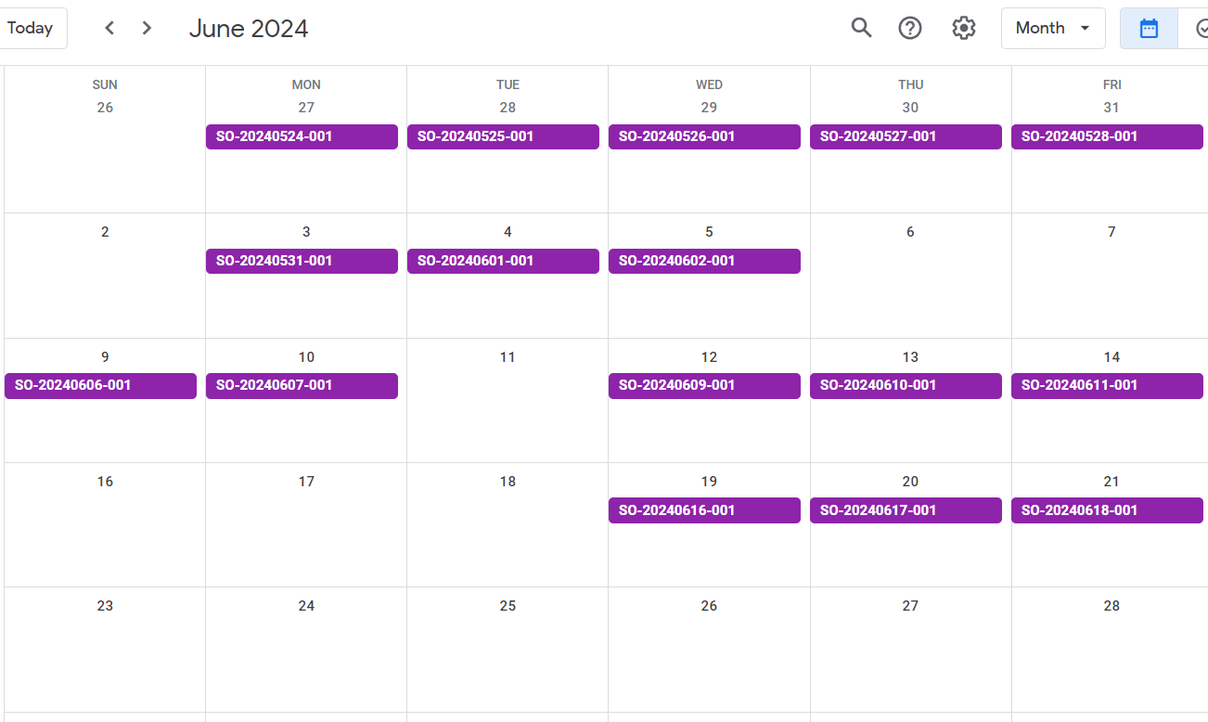
Calendar Sync
Track all the dates in the database with your favorite calendar application

Slide 29
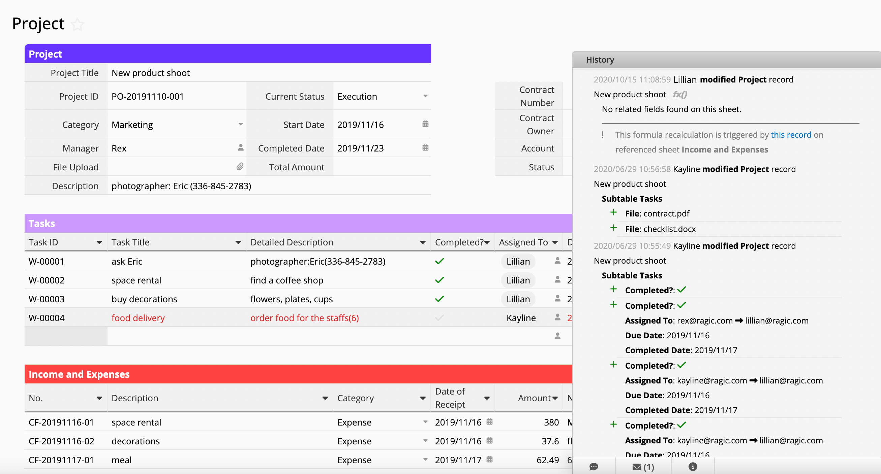
Clear Version History
Complete version history showing all modifications to the entry
2020/10/15 11:08:59 Lillian modified
Project record New product shoot
  fx()
!
This formula recalculation is triggered by
this record on referenced sheet Income and Expenses
2020/06/29 10:56:58 Kayline modified
Project record New product shoot
Subtable Tasks
File: contract.pdf
File: checklist.docx
2020/06/29 10:55:49 Kayline modified
Project record New product shoot
Subtable Tasks
Completed?:

Slide 30

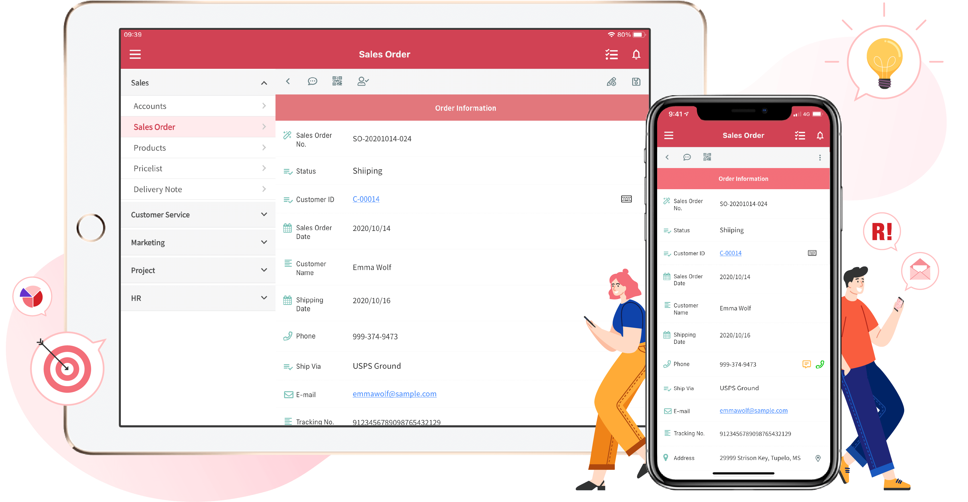
Mobile Access
View, enter, and edit records on the go

Slide 31
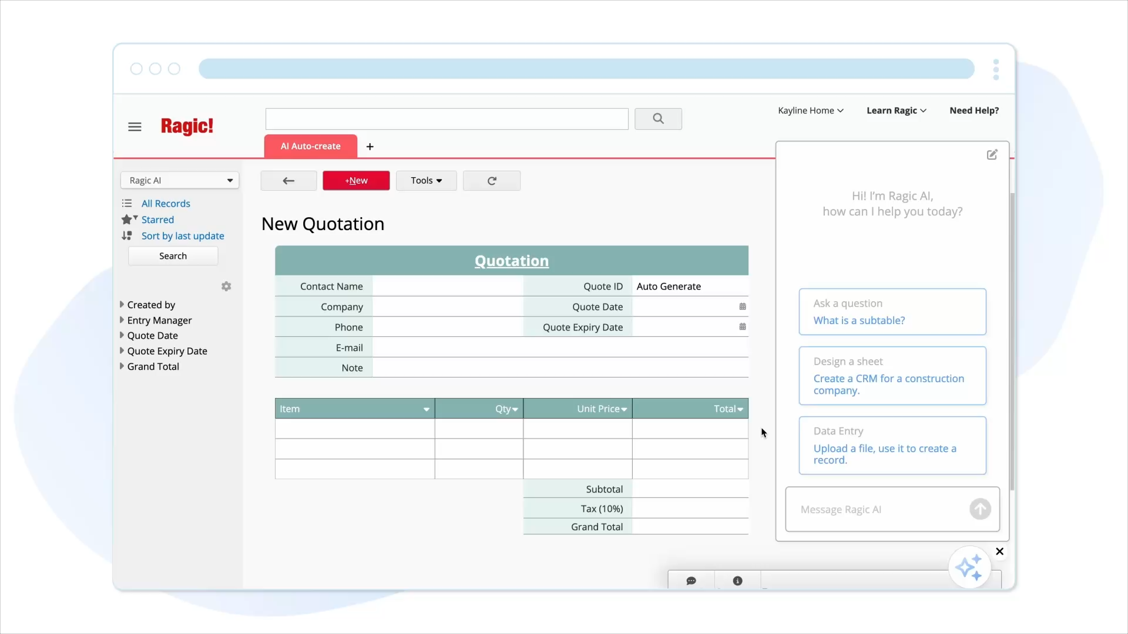
Ragic AI

Slide 32







Learn Ragic!
Learning Center
Design Guide & User Guide
FAQ & API Developer Guide
YouTube Channel
Webinars
Blog & Community

Slide 33
Technology Stack

Slide 34

Simple but robust RESTful HTTP API
Ragic offers RESTful HTTP API that lets you read from and write to your Ragic database using your own code
Reading > GET
Authentication
with API Key
Database Info
Ex: field ID,
server name
Creating & Modifying
> POST
Send API Request
Receive Response
Deleting > DELETE

Slide 35

Customized Scripting
  No matter how complex your business logic is,
  it can be done with our server-side Javascript workflow engine

Slide 36
Technology Stack
Easy to deploy, cross-platform Java solution
Java-based
Deploy on Linux and Windows servers
Embedded application server (Jetty),
embedded DB (Berkeley DB)
Easy to install and deploy
No need to install a separate AP server or database.
NoSQL DB for high performance on flexible data structure
Javascript/HTML/CSS Interface
No need to install any plugins; all browsers can run it

Slide 37
On-premises VS Cloud-hosted
You can host Ragic on your own server if necessary, provided that your organization has an experienced IT crew who understands how to maintain and keep a server safe and secure.
Requirements:
Professional IT personnel with experience in maintaining network servers
10 users minimum
Paid annually
Professional, Concurrent, and Enterprise Plans
If you choose the on-premises option, you will be responsible for the following maintenance tasks:
Update SSL, Configure backups, Set up the server firewall, Adjust system parameters and allocate resources to ensure performance (memory/Swap/disk I/O), Update the server operating system, Ensure OS-level security settings comply with standards

Slide 38
Case Studies

Slide 39






















Trusted by organizations of all sizes around the world

Slide 40







Customer Stories
Abrolhos Islands Management Council
Nexus Software Solution
Wishbone Site Furnishing
How a Simple Setup Eliminated the Need for an Additional Hire
Ragic Partner Peter Teichroeb Scaled a Business 6x
From CRM to Production Automation That Drove a 6X Revenue Growth
Cameron Racing
Do it Best Corp
Harry Potter Film Concerts - CineConcerts
A Flexible System Driving Efficiency for a Fast-Moving Team
A Project Management Database Without Writing Any Code
4-Person Team Stay on Top of Over 300 Annual Performances

Slide 41






Customer Stories
InterContinental Kaohsiung Hotel
Beer Square
Artistic Stone Design
Less Overtime. Lower Staff Turnover.
All While Cutting Operational Costs
From Excel to Ragic : My Database (R)evolution
For Unmatched Ease of Use -
Choosing Ragic Over Microsoft Access
Deliveree
R&R Industries
Resort Travel Management
The Largest Trucking Platform in Southeast Asia Powered by Ragic
The Power of Being Proactive Instead of Reactive
From Dysfunctional Spreadsheets to a Comprehensive Ragic Database

Slide 42

Adopted by 3,000+ companies worldwide
- including Fortune Global 500
2010
2012
Now
Release Ragic Builder
“Product to Watch”
eWeek Magazine
“Echelon Taiwan
Satellite award”
Red Herring Global Top 100 Finalist for Innovative Tech
Generative AI & Learning Ragic, Integrations, Reporting, General UI improvements
2011
2013
2008
“Top 10 Startups in Taiwan”
Business Next
“Asia America Multi-Technology Association (AAMA) Program”
Established in Taipei
Represented Interwoven Teamsite

Slide 43






Why Stands Out for Enterprises
Ragic does it better—quicker and with less hassle
Why enterprises choose Ragic over Airtable
How does Ragic fill the gaps in ERP systems
Why Ragic is better than monday.com for enterprises?
Why manage projects with Ragic, not Notion?
More powerful than
Google Forms

Slide 44
Pricing

Slide 45


Pricing & Plan
Custom Sheets?
All versions come with free templates available for download, and there is no limit on the number of records in the templates
User?
Most popular

Slide 46
Credit Card
Bank Transfer
Adjust the number of users at any time
Account Billing > Billing History > Access the invoices of your payments
Pay monthly or annually
One month free with a one-year
subscription!
Purchase annually with full upfront payment
No refunds will be issued for reductions in users, downgrades, or cancellations during the subscription period
Receive a quote from us by emailing us your request (payment instructions)
Calculation：2025/06/19~2026/06/19 PROF plan+ 5 users + One-year subscription
1. Credit Card
$19 USD ╳ 5 users ╳ 12 months
− 1 month free with a 1-year subscription
= $1,045 USD
2. Bank Transfer
$19 USD ╳ 5 users ╳ 12 months
= $1,140 USD

Slide 47
Security

Slide 48

Data Security Measures
ISO 27001 and Compliance
Application Architecture Security
Physical Security
People Processes
Network and System Security
Backups & Disaster Recovery
Storage Security
On-premise Servers

Slide 49
Backups & Disaster Recovery
Multiple layers of backup to keep you from data loss
System Wide Backups
All Ragic servers are fully backed up on a daily basis to ensure service can be quickly recovered in case of any problem.
Account Database Backups
For professional plans and above, accounts have their own individual full daily, weekly, and bi-weekly database backups to a different location on a service by a different provider to ensure that you can restore your data in any situation.
We also allow you to manually backup, take snapshots, or restore your account database with a backup yourself.
Manual Backups
Ragic also allow users to manually backup and download your data to manage your backups yourself (available to Professional, Concurrent, Enterprise plan).

Slide 50


ISO 27001 & Compliance
ISO 27001 Information Security
Data Privacy Framework
ISO/IEC 27001 is a global standard for managing information security, introduced by ISO and IEC in 2005 and updated in 2013 and 2022. It provides guidelines for creating and continually improving an Information Security Management System (ISMS) to enhance the security of organizational information assets.
Ragic has been certified with the ISO/IEC 27001:2022 standard. We implement information security protection and prevention measures following relevant governance methods.
The EU-U.S. Data Privacy Framework and the Swiss-U.S. Data Privacy Framework ("Data Privacy Framework") provide a mechanism for companies in Europe and America to comply with data protection requirements.
Ragic has been certified to the Data Privacy Framework as set forth by the U.S. Department of Commerce regarding the collection, use, and retention of personal data transferred from the EEA, the United Kingdom, and Switzerland to the United States.

Slide 51
GDPR Compliance
（General Data Protection Regulation）
HIPAA Compliance
Ragic complies with the General Data Protection Regulation (GDPR) with procedures for data erasure, personal info protection, and data transfers.
We routinely evaluate risks, bolster security, and detail our practices in our privacy policy.
We have European servers located in Belgium and Ireland. Users from other regions can also inquire about moving their databases to European servers.
Ragic complies with the Health Insurance Portability and Accountability Act (HIPAA), safeguarding the process of handling, storing, and transmitting Protected Health Information (PHI).
Our hosting service providers, AWS and GCP, also adhere to these standards and can sign a Business Associate Agreement (BAA) when required.

Slide 52
Storage Security
Disk Encryption, RAID storage, and Backups
Disk Encryption:
  All data written to disk is encrypted on the fly and then transmitted and stored in encrypted form. Conforming to ISO 27001, SSAE-16, SOC 1, SOC 2, and SOC 3 certifications.
RAID storage:
  All data is mirrored to multiple RAID hard disks, ensuring your data is safe from hard disk failures.
Server Backup:
  All servers are backed up daily to a different set of persistent storage.
Database Backup:
  All customer databases are backed up to a different location for disaster recovery.

Slide 53
Network and System Security
Encryption, intrusion detection, and auditing logs
SSL Encryption:
  All data transmissions support bank level HTTPS/SSL encryption. SSL encryption is always enforced when sending sensitive information.
Intrusion Detection:
  Packets sent to servers go through a series of strict firewall rules and application-level intrusion detection and blocking programs to stop malicious requests and IPs in real time.
Complete Audit Logs:
  All requests, system events, application events, database events are logged and ready for expert analysis. Periodic review of all logs to make adjustments for new defense policies.

Slide 54
Application Architecture Security
A robust application architecture is the most important line
of defense for your data
Database security:
  Ragic's database has a unique design that does not support SQL or any other query language. There is zero chance of SQL or script injection. Different tenants' databases are stored in separate physical files, ensuring zero chance of application-level sharing exploits from other accounts.
Periodic Security Scan:
  We work with major service providers to perform periodic security scans for all possible weaknesses to ensure your data's safety.
Regular Security Updates:
  Our system administrators monitor security updates very closely and apply patches to deflect zero-day attacks.

Slide 55
People processes
Nobody can access your data without your permission
Data Access Control:
  Nobody, including system administrators at Ragic, can access your data without your permission. When providing technical support, we can only see your database design, but not your data by default.
No Database Management Interface:
  Unlike most other databases, there is no interface to manage databases or play around with your data. Without such a feature, your data is safe from any unauthorized access to your data via database consoles or any management interfaces.
Complete Access Log:
  All data access are logged, and special events are reviewed regularly.

Slide 56




Physical Server Security
World-class cloud service providers ensure the physical security of our servers
Our servers are provided by well-known public cloud providers (Google, AWS), with features including:
1. Annual audits for the following standards: ISO 27001, SOC1, SSAE16 / ISAE 3402 Type II: SOC 2, SOC 3, PCI DSS v3.0
2. Information Security Team consisting of more than 500 top experts.
3. Custom-designed electronic access cards, alarms, vehicle access barriers, perimeter fencing, metal detectors, and biometrics

