Slide 1
Ragic Database Design 101
START!

Slide 2
Introduction
3
Basic
9
Designing your Ragic application
Managing users
29
Searching and filtering
39
47
Integrating with Excel
CONTENT
Advanced
55
Building data relationships
Improving efficiency with one click
74
92
Reports
Database settings
106
Extra
Online support
Click on title to jump to a chapter
115

Slide 3
Introduction
3

Slide 4
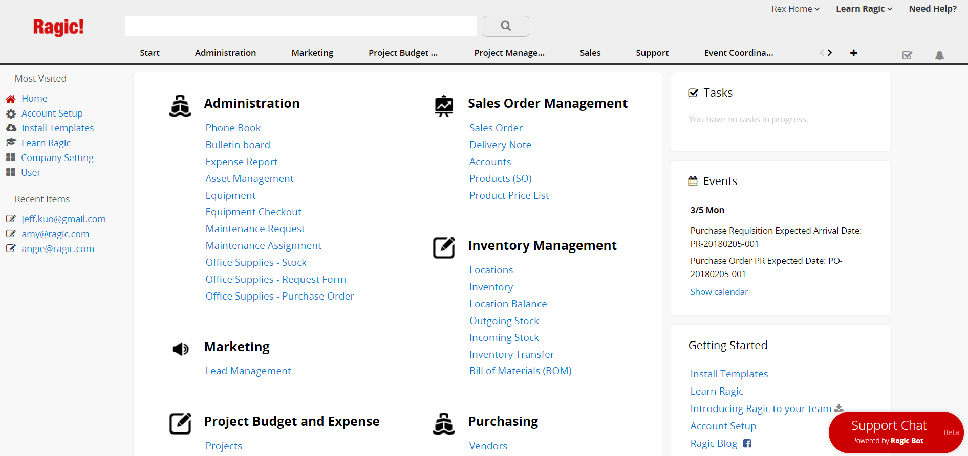
Introduction 1
A complete database can contain all kinds of business applications.
4

Slide 5
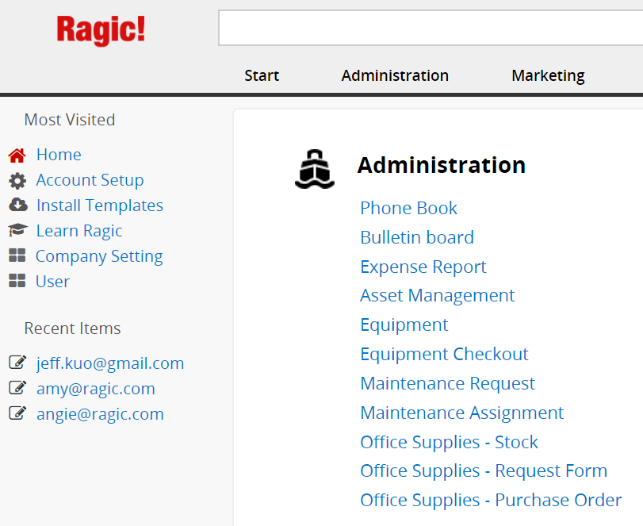
Introduction 2
1
Tab
2
Sheets
5

Slide 6
Introduction 3
1
Click on a sheet to access records
6

Slide 7
Introduction 4
The“Listing Page” is a table that contains the summary of many entries.
1
Click to see the details of this entry
7

Slide 8
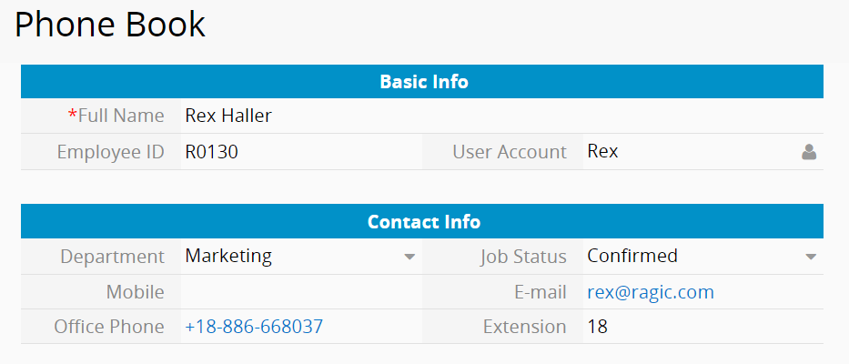
Introduction 5
The“Form Page” is the full detail of a single entry as a page.
1
Field
8

Slide 9
Designing your Ragic application
Get the hang of Ragic
9

Slide 10
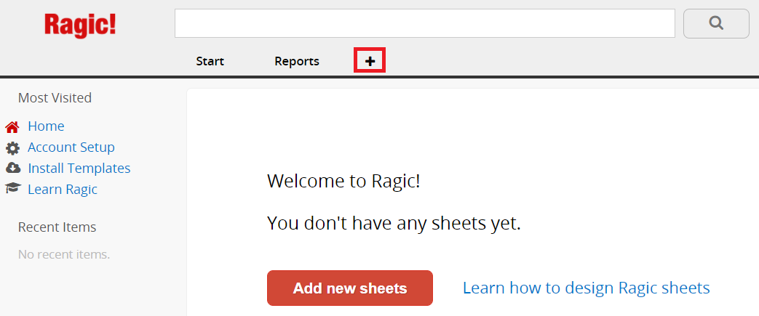
Design application 1 – Create sheet
Design your own sheet
1
Create new tab and sheet
10

Slide 11
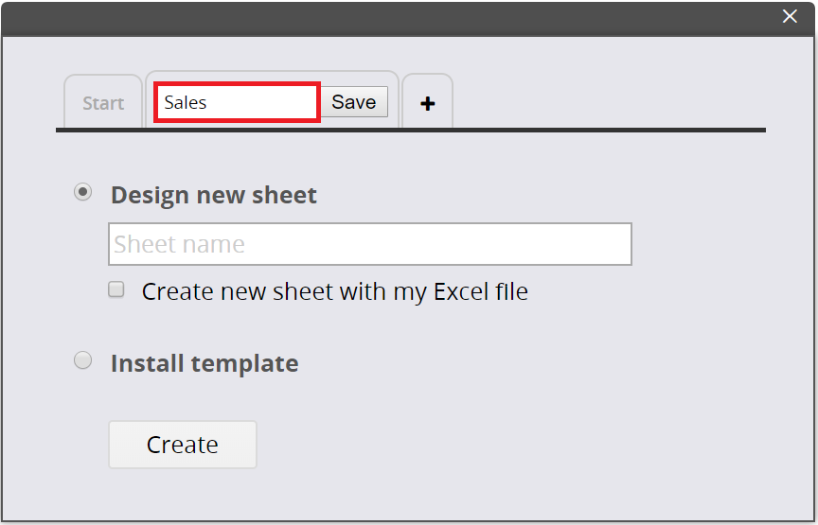
Design application 2 – Create sheet
1
Name your tab
11

Slide 12
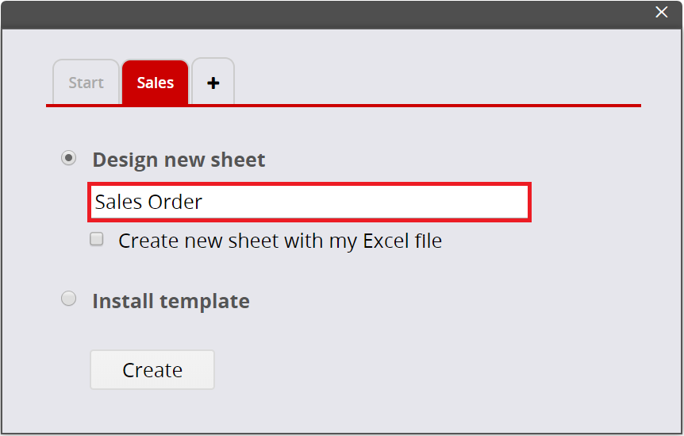
Design application 3 – Create sheet
1
Name your sheet
12

Slide 13
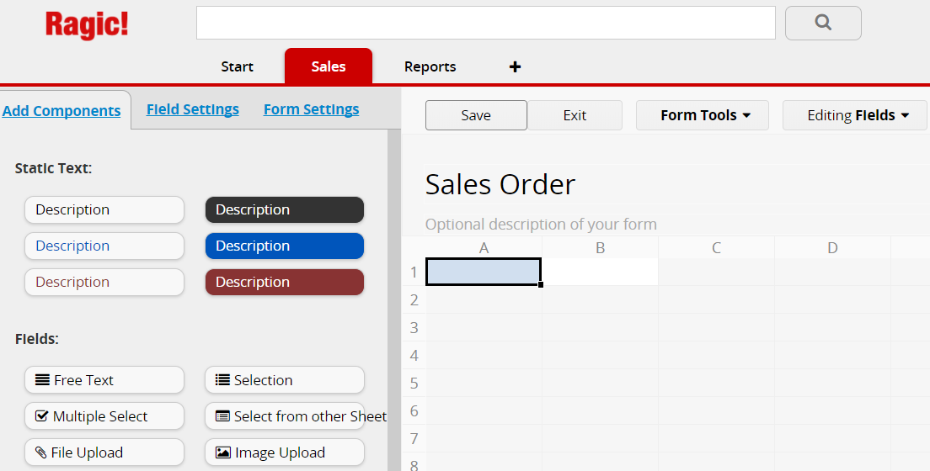
Design application 4 – Create fields
1
Type the field name that you would like to create
13

Slide 14
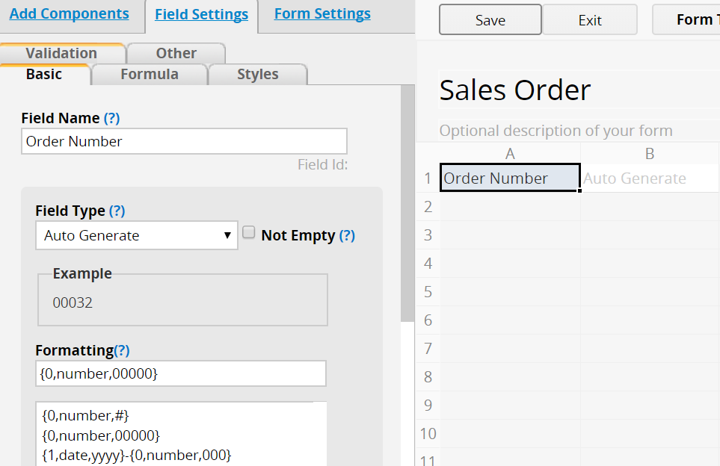
Design application 5 – Create fields
Field Settings
1
Field Type
2
Field Name
3
Field Value
14

Slide 15
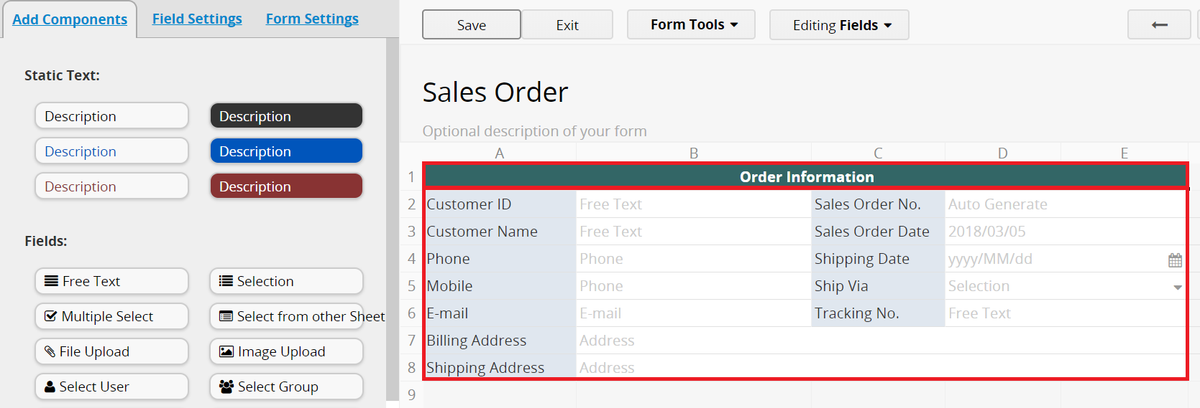
Design application 6 – Create fields
1
Field Description
2
Fields
15

Slide 16
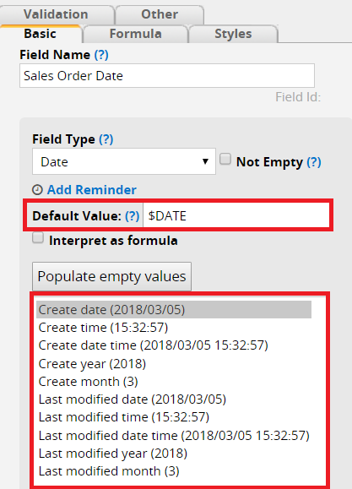
Design application 7 – Create fields
Default Value
1
Set up Default Value
2
Format
3
Fill out this field
16

Slide 17
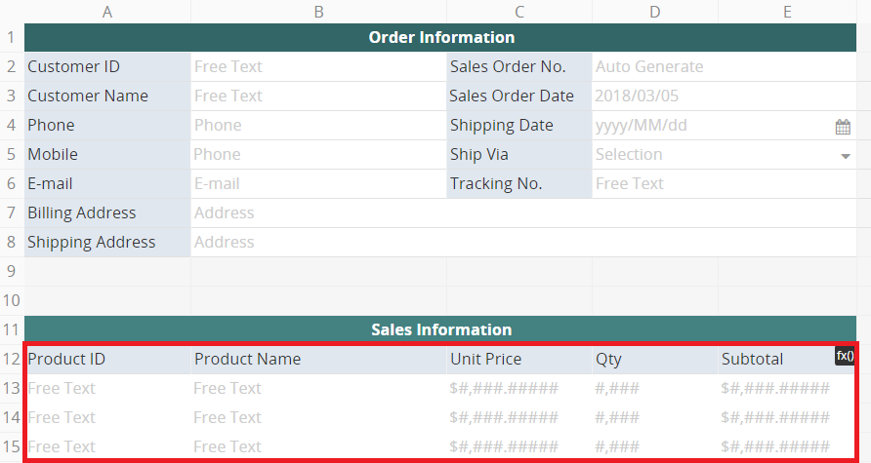
Design application 8 – Subtable
Handling one-to-many relationships
1
Subtable
17

Slide 18
Design application 9 – Formula
Applying a formula
1
Set up Formula
2
Assign to Field Header
18

Slide 19
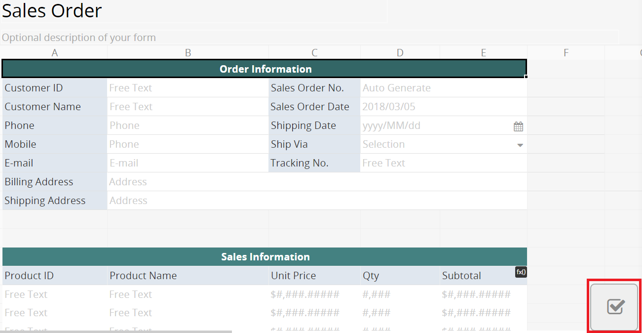
Design application 10 – Approval
Setting up approval flow
1
Configure approval flow
19

Slide 20
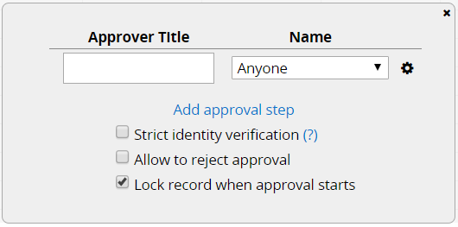
Design application 11 – Approval
1
Click to configure
2
Add approval step
3
Set the approver
20

Slide 21
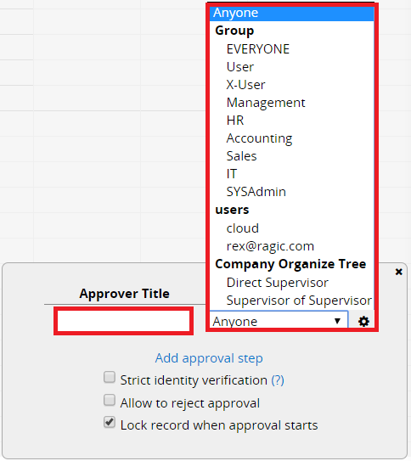
Design application 12 – Approval
2
Select Approver
1
Approver Title
21

Slide 22
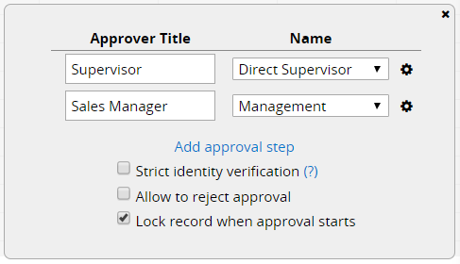
Design application 13 – Approval
Done!
22

Slide 23
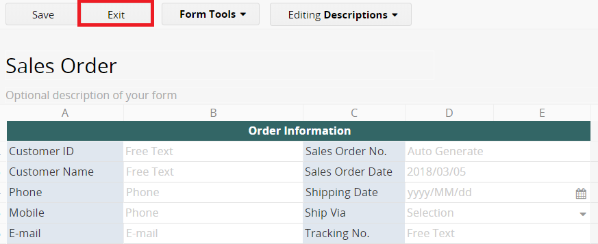
Design application 14
1
Remember to save before leaving “Design Mode”
23

Slide 24
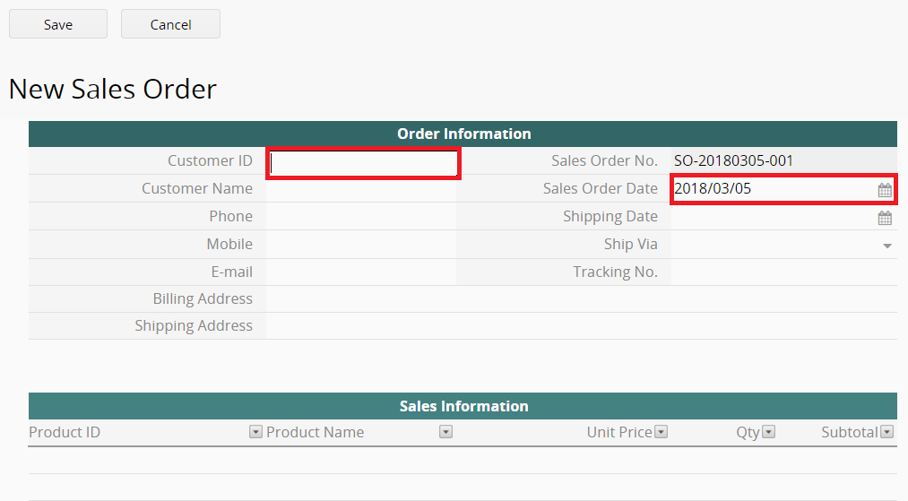
Design application 15 – Adding an entry
1
Input Data
2
Default Value
24

Slide 25
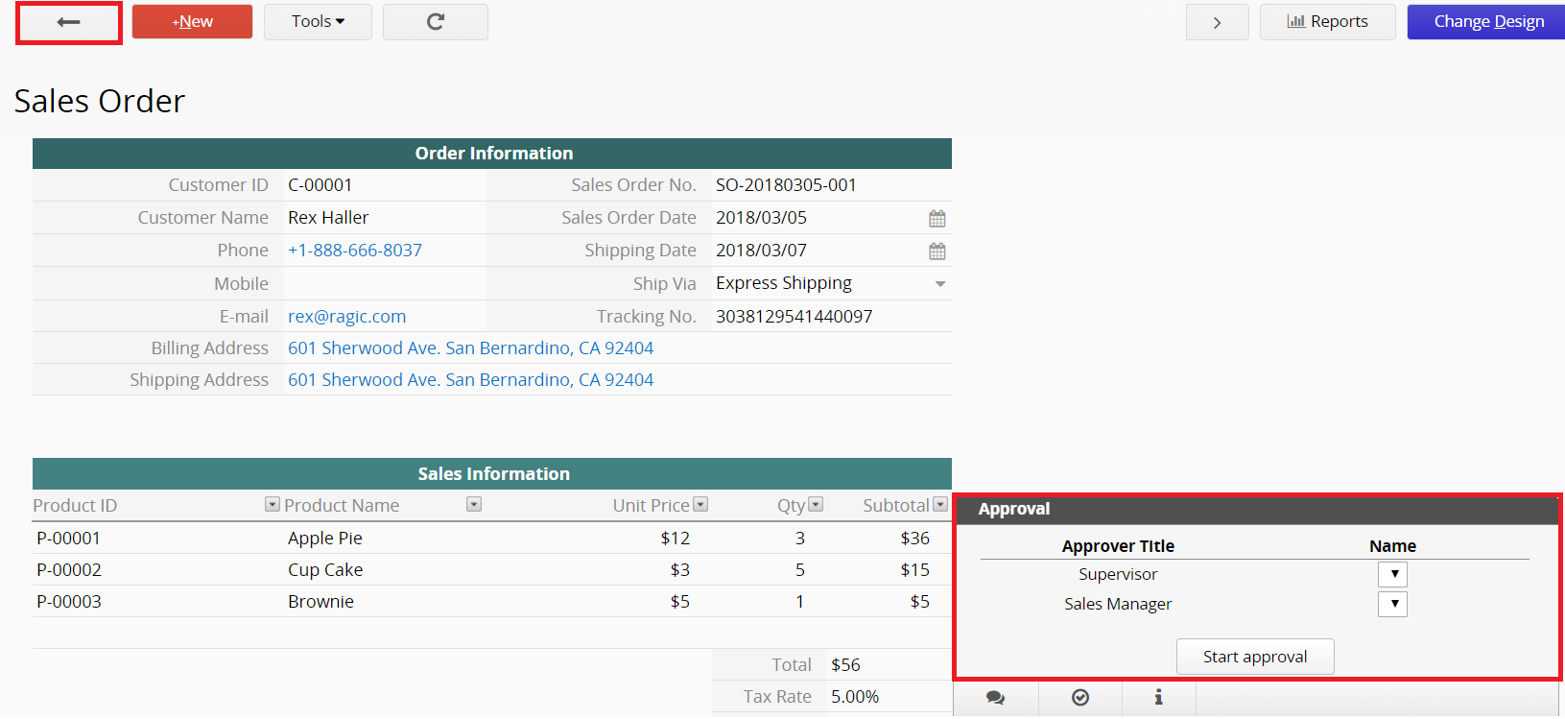
Design application 16 – Adding an entry
Form page
1
Back to listing page
2
Approval
25

Slide 26
Design application 17 – Adding an entry
Listing page
26

Slide 27
Design application 18 – Listing page
Fields Displayed on the Listing Page
1
Click on “Change Design” on listing page
27

Slide 28
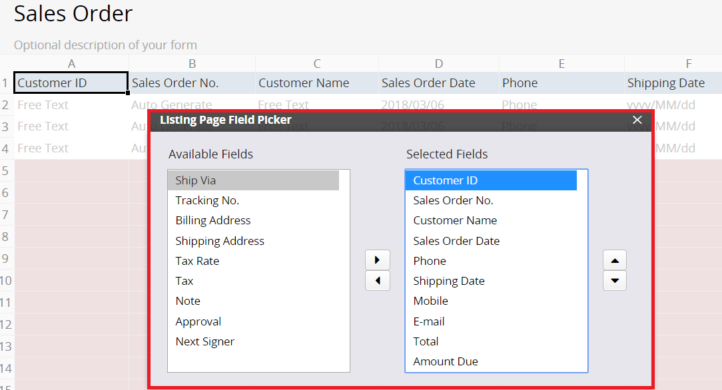
Design application 19 – Listing page
1
Choose the fields that will be displayed in
the listing page
28

Slide 29
Managing users
Get the hang of Ragic
29

Slide 30
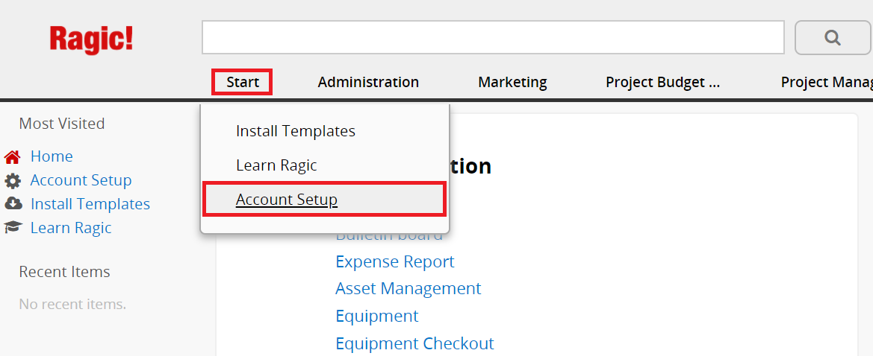
Managing users 1
Adding new users
1
Define user groups
2
Configure access rights
3
Add new users and assign them to appropriate groups
30

Slide 31
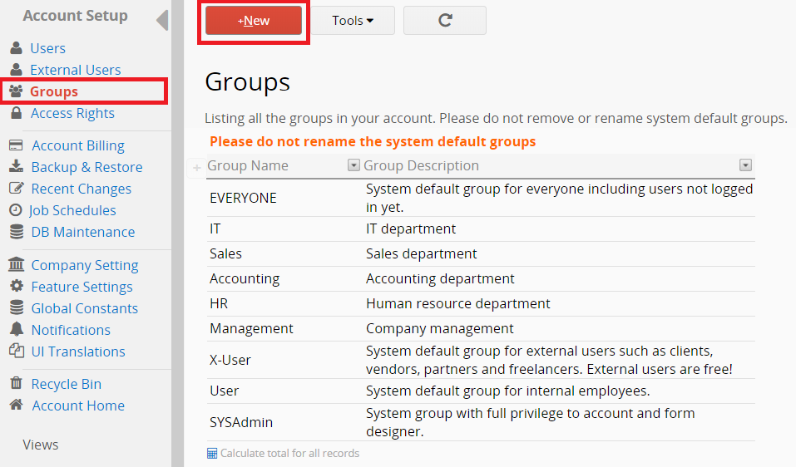
Managing users 2
Need more groups?
1
Just add the new user groups that you need
31

Slide 32
Managing users 3
Configure access rights on all of sheets for each user group
1
Option 1: Global Access Rights Panel
32

Slide 33
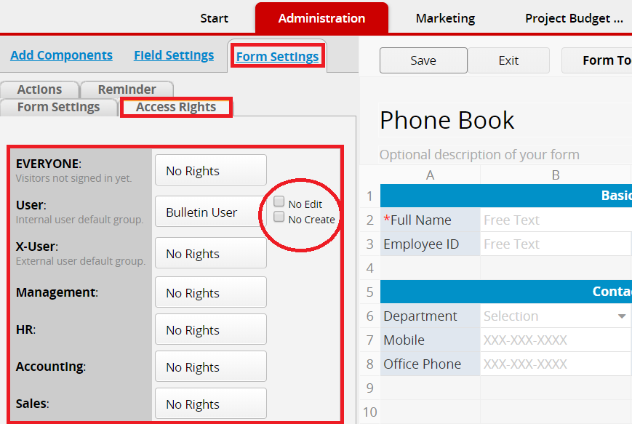
Managing users 4
1
Option 2: Setting up Access Rights for Individual Sheets
2
Additional Access Rights Settings
33

Slide 34
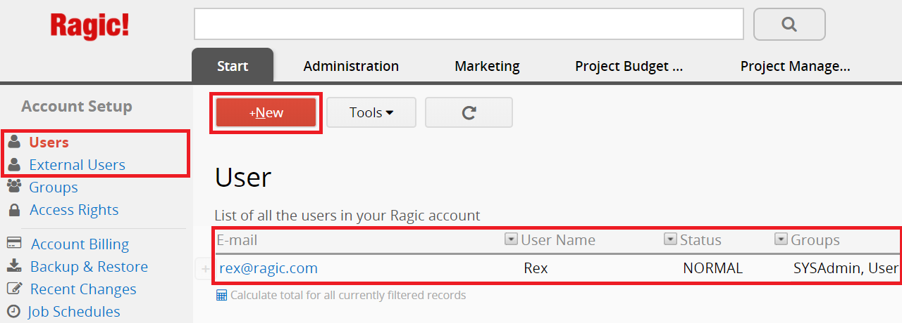
Managing users 5
1
Add new users
2
List all users in this database
34

Slide 35
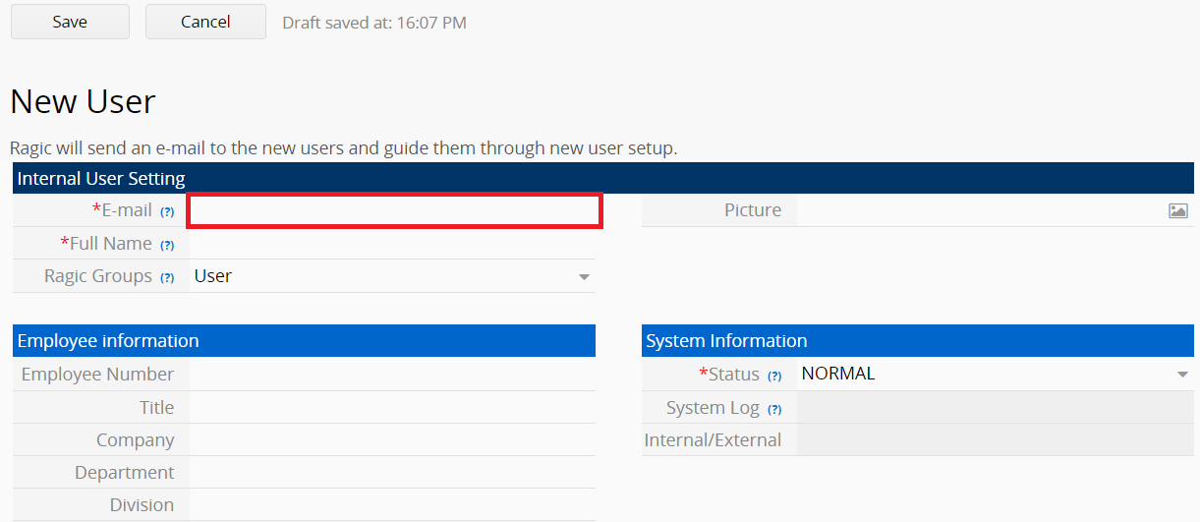
Managing users 6
1
Ragic will send an e-mail to the new users and guide them through the setup process
35

Slide 36
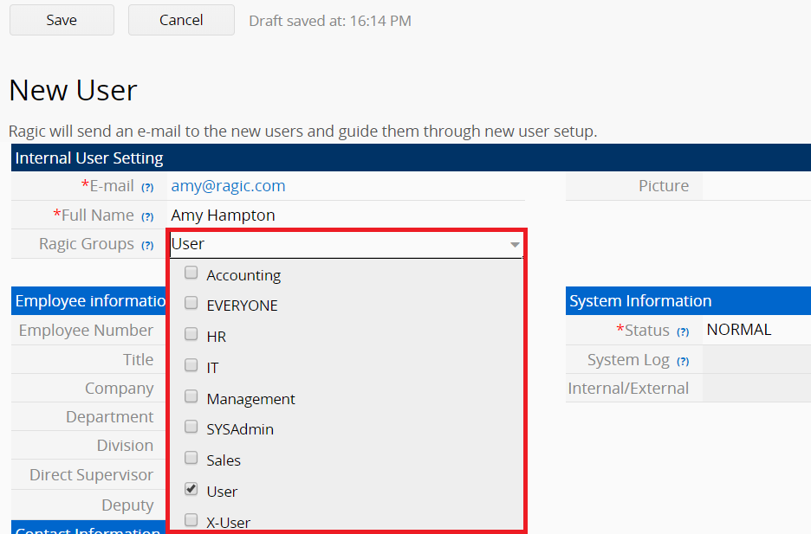
Managing users 7
1
You can assign users to more than one group
36

Slide 37
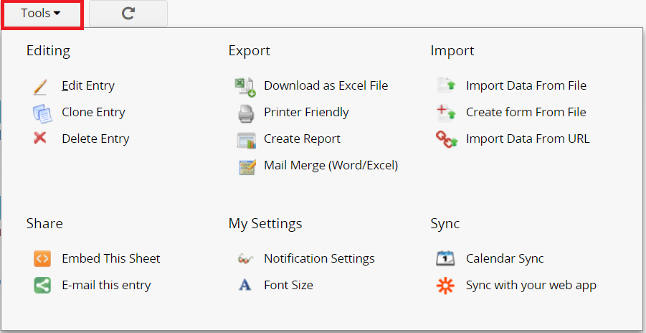
Managing users 8
Decide who can access these features
37

Slide 38
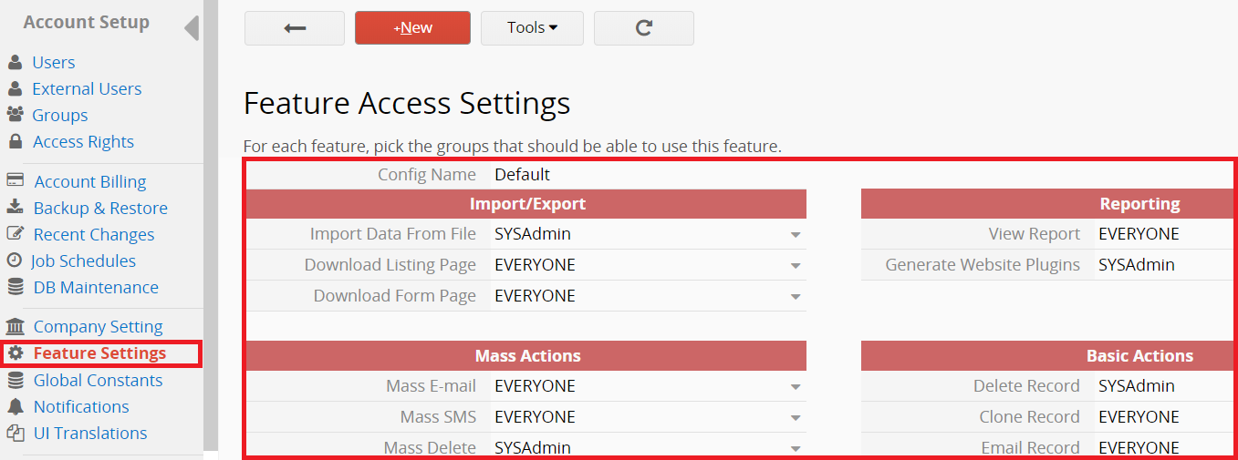
Managing users 9
Decide who can access these features
1
Configure feature access rights for user groups
38

Slide 39
Searching and filtering
Get the hang of Ragic
39

Slide 40
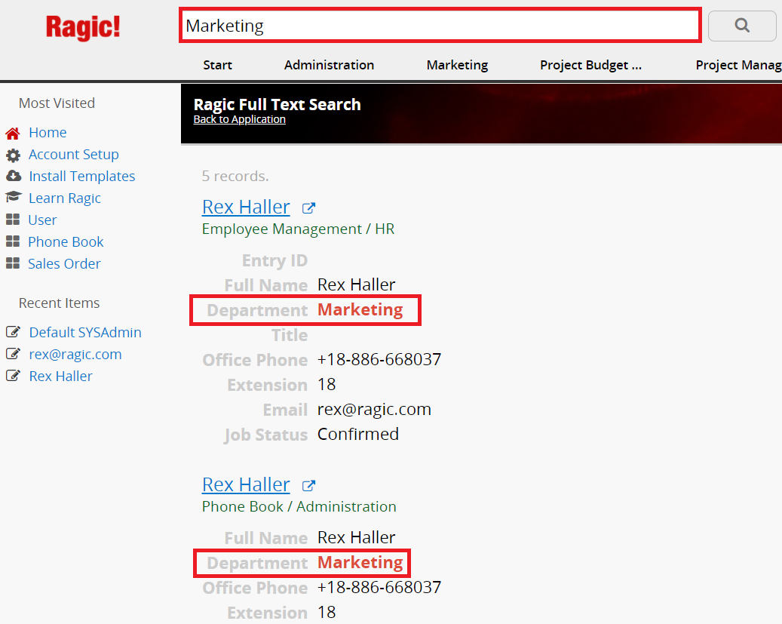
Searching 1
Full Text Search
1
If you search on the “Home page”, the full text search results will apply to the entire database
2
If you search on a specific sheet, the full text search results will only apply to that sheet
40

Slide 41
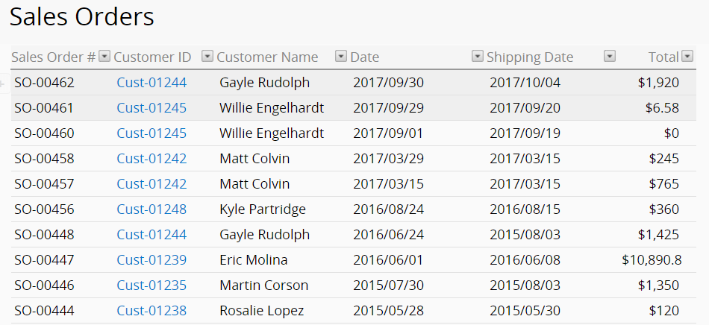
Searching 2
Filter Specific Field
41

Slide 42
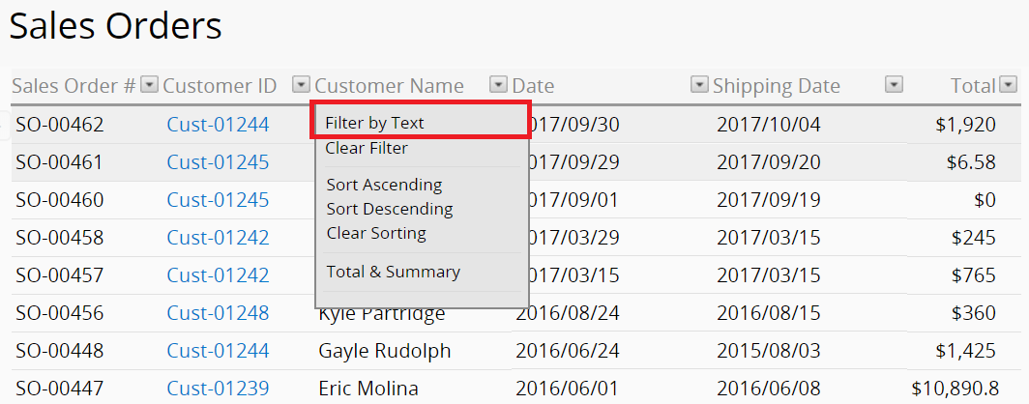
Searching 3
Filter Specific Field
42

Slide 43
Searching 4
Filter Specific Field
1
Input your query
43

Slide 44
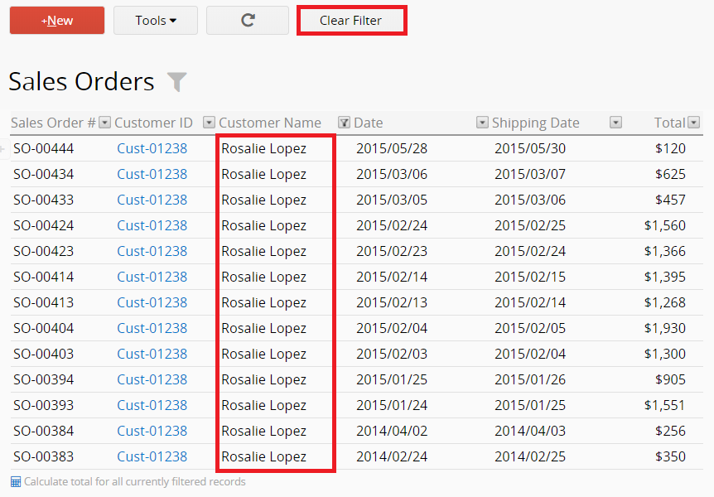
Searching 5
Filter Specific Field
1
Clear Filter
2
Result
44

Slide 45
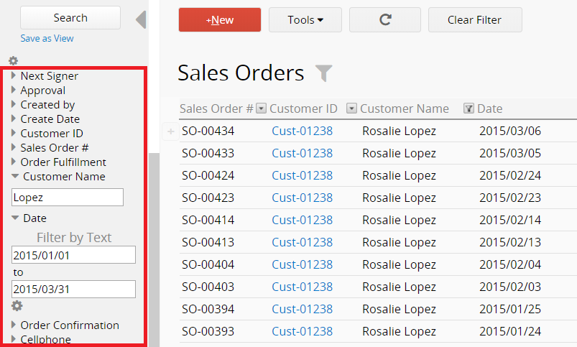
Searching 6
Filter more than one field
45

Slide 46
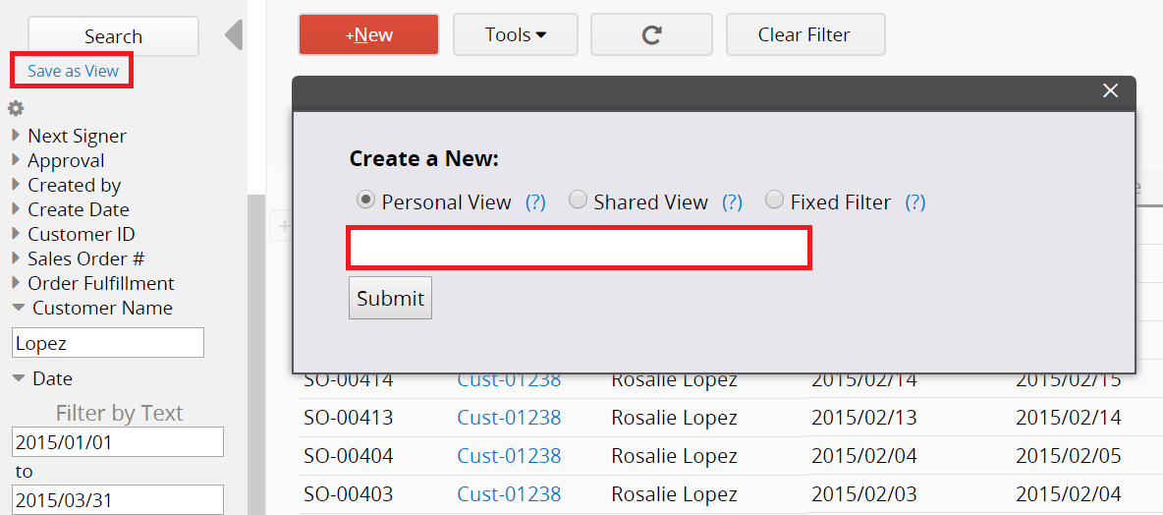
Searching 7
Saving frequent searches as views
1
Click
2
Name this view
46

Slide 47
Integrating with Excel
Get the hang of Ragic
47

Slide 48
Integrating with Excel - 1
Prepare Import Files
1
The headers of the fields
2
Key field
48

Slide 49
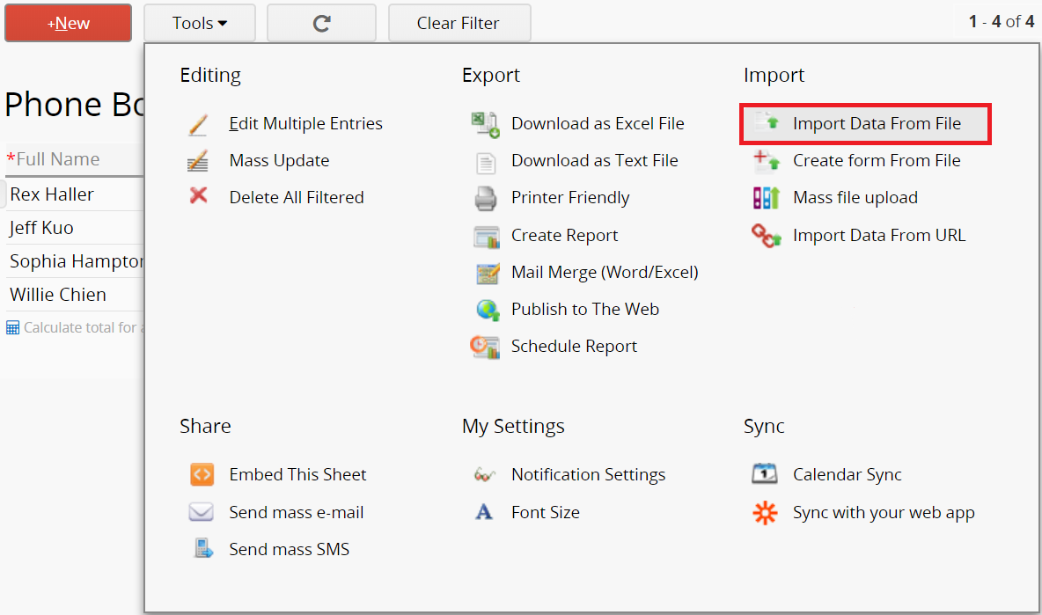
Integrating with Excel - 2
Import File
1
Click
49

Slide 50
Integrating with Excel - 3
Import File
1
Choose File
2
Upload
3
Next
50

Slide 51
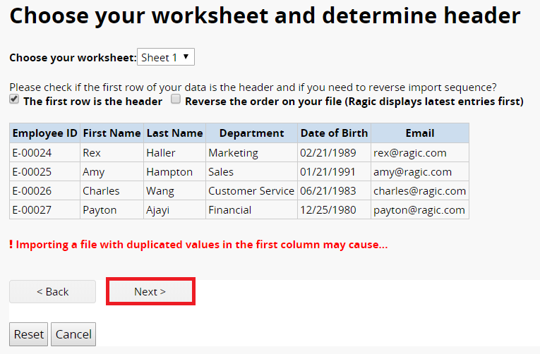
Integrating with Excel - 4
Import File
1
Next
51

Slide 52
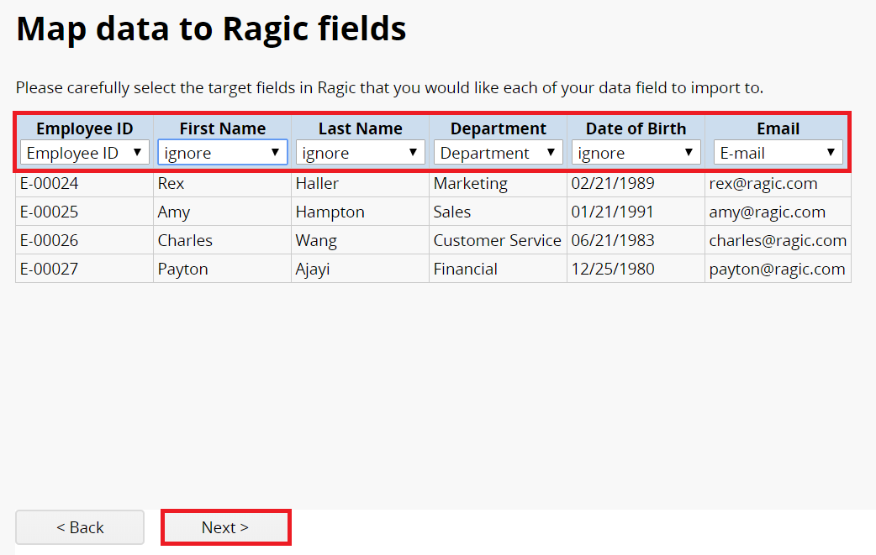
Integrating with Excel - 5
Import File
1
Map Fields
2
Next
52

Slide 53
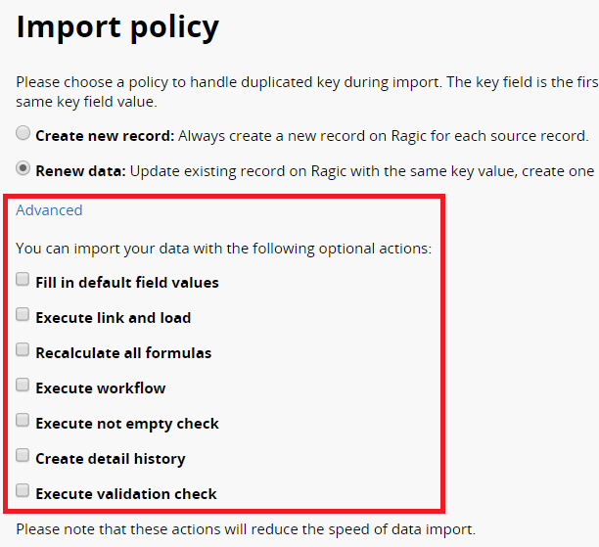
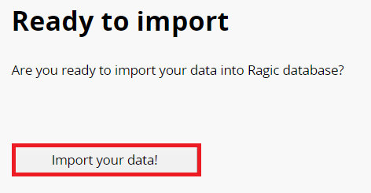
Integrating with Excel - 6
Import File
2
Import
1
Advanced Settings
3
Back to database
53

Slide 54
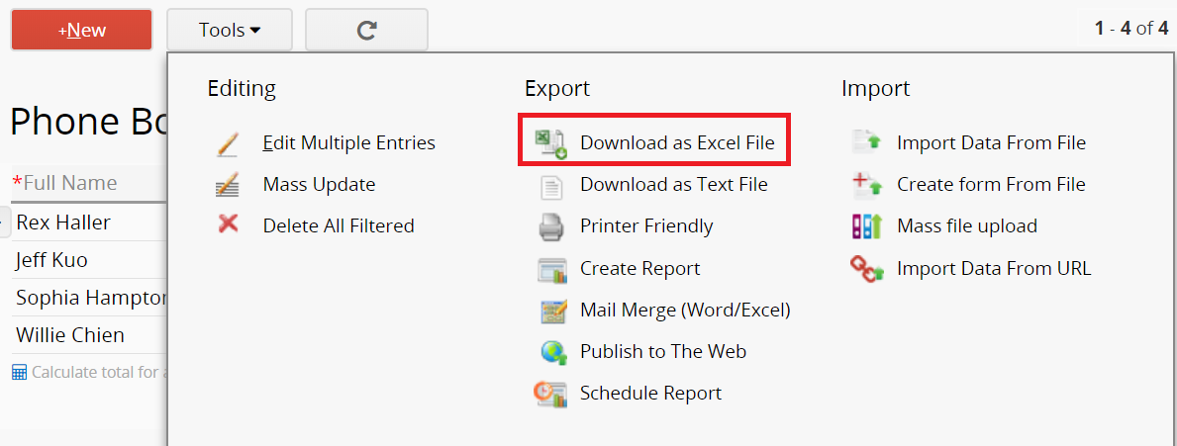
Integrating with Excel - 7
Export File
1
Click to download
2
Download Configuration
54

Slide 55
Building data relationships
The Road to Mastery
55

Slide 56
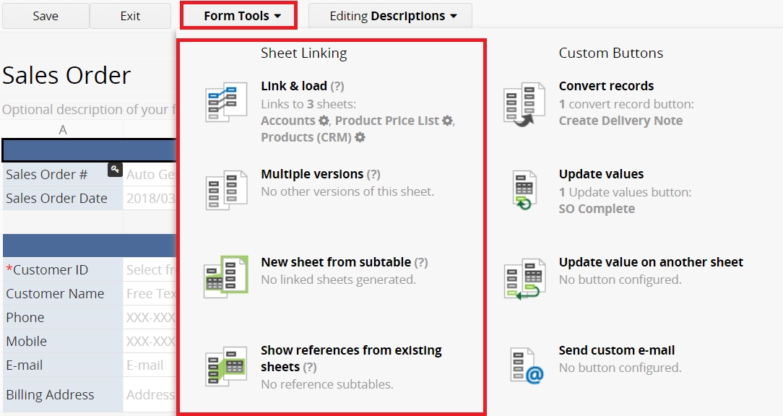
Data relationship
Linking sheets together
1
Four different linking tools
56

Slide 57
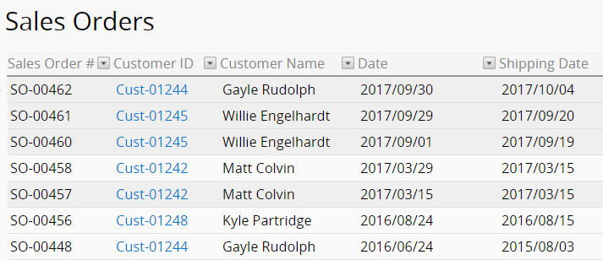
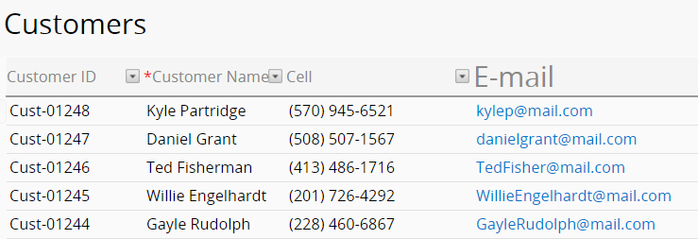
Data relationship 1-1
Case 1: When entering sales orders, we want to populate the related customer information which is saved in another form.
57

Slide 58
Data relationship 1-2
1
Click here
2
Select from“Customers”sheet
58

Slide 59
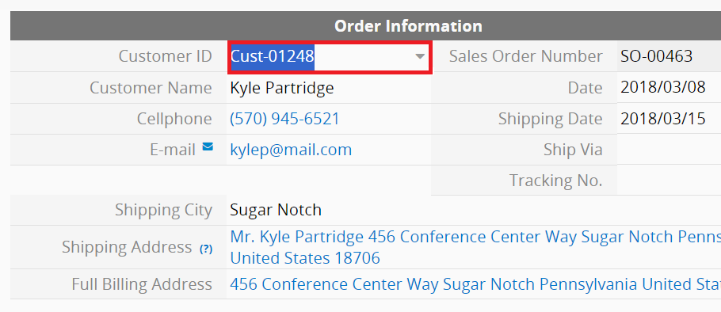
Data relationship 1-3
1
Select customer ID
2
Populate corresponding information
59

Slide 60
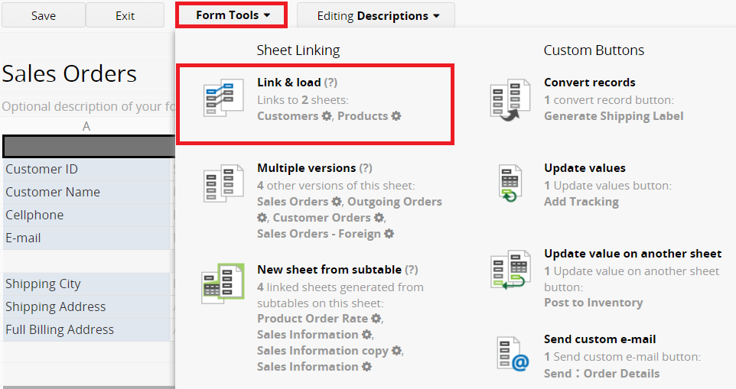
Data relationship 1-4
Link & Load
1
Click
60

Slide 61
Data relationship 1-5
Link & Load
1
Set up the Linked Field
61

Slide 62
Data relationship 1-6
Link & Load
1
Link the Loaded Fields to the corresponding cells
62

Slide 63
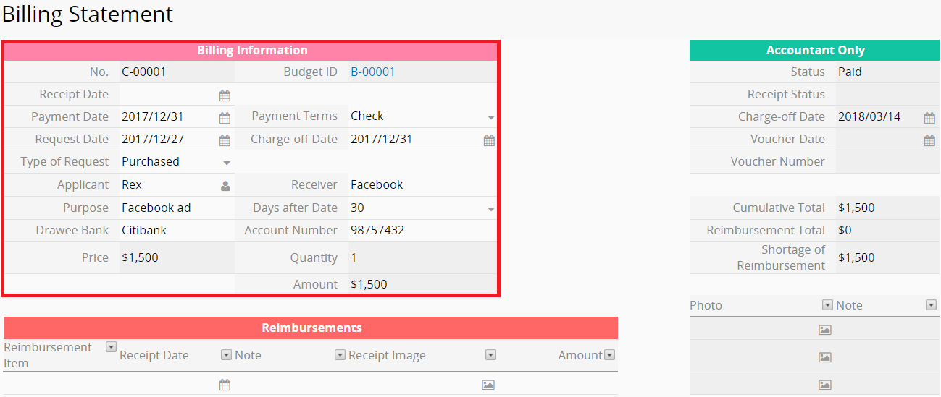
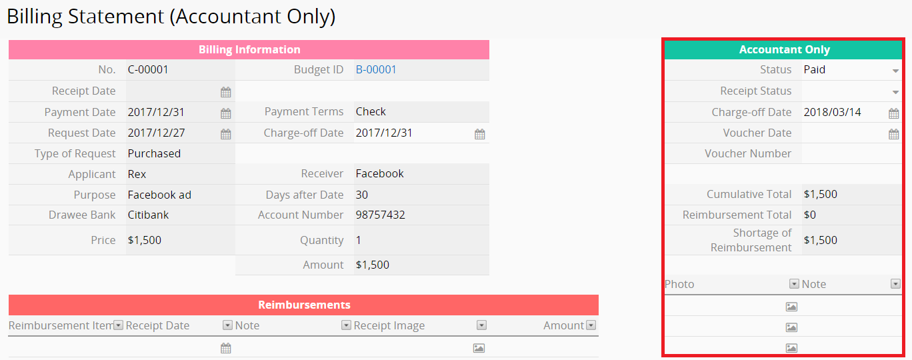
Data relationship 2-1
Case 2: Sometimes you will want to create different versions of the same form so that different groups of users can see different versions.
63

Slide 64
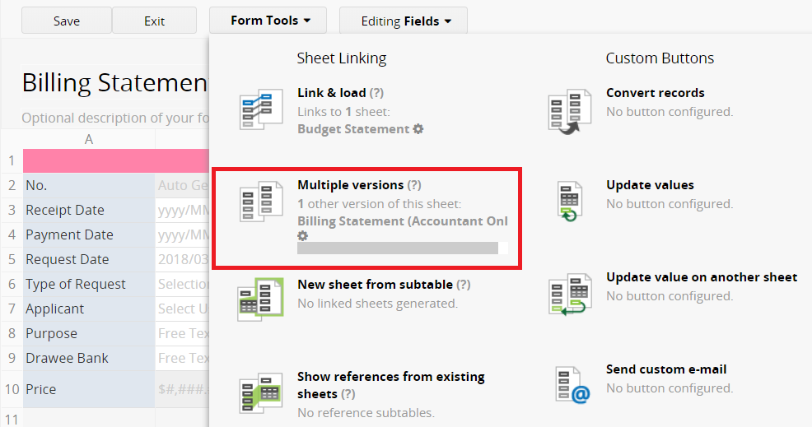
Data relationship 2-2
Multiple Versions
1
Click here
2
Duplicate Sheet
64

Slide 65
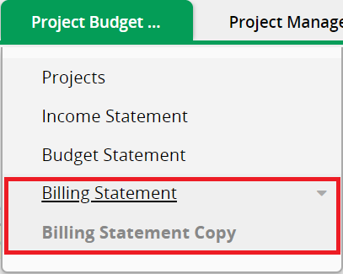
Data relationship 2-3
Multiple Versions
1
All edits and deletion of entry values will be reflected on both sheets
65

Slide 66
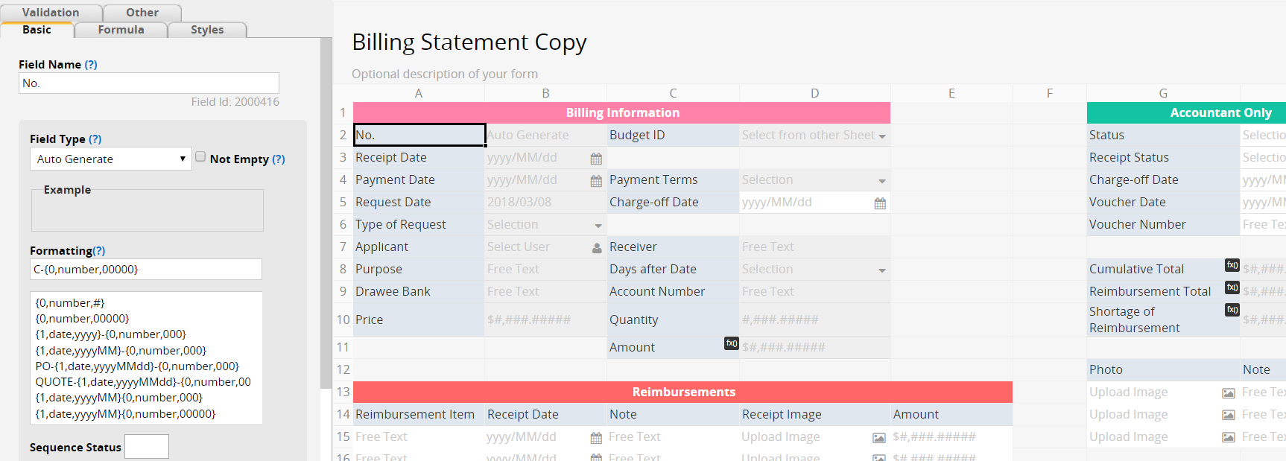
Data relationship 2-4
Multiple Versions
1
Fields, access right and layout can be different from another sheet
66

Slide 67
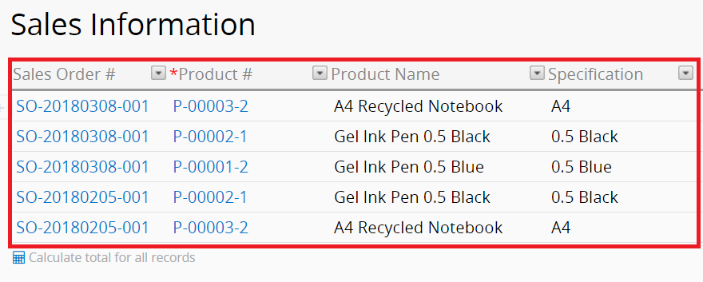
Data relationship 3-1
Case 3: To make the data in the subtables more accessible, you can create a new sheet from a subtable.
1
Contains all of the subtable entries
67

Slide 68
Data relationship 3-2
New Sheet from Subtable
1
Click
2
Create new sheet
68

Slide 69
Data relationship 3-3
New Sheet from Subtable
1
The newly created form will contain an additional field that will link back to your original form
69

Slide 70
Data relationship 4-1
Case 4: To see all sales orders a customer has placed, we can add a reference subtable on the Accounts sheet.
70

Slide 71
Data relationship 4-2
Show References from Existing Sheets
1
Click
2
Choose the sheet you want to reference to
71

Slide 72
Data relationship 4-3
Show References from Existing Sheets
1
Insert reference table
72

Slide 73
Data relationship 4-4
Show References from Existing Sheets
1
All of the order records of that account
73

Slide 74
Improving efficiency with one click
The Road to Mastery
74

Slide 75
Improving efficiency
Have work done with one click!
1
Four different
custom buttons
75

Slide 76
Improving efficiency 1-1
Case 1: Creating a button to post some values in this entry to be saved in another sheet.
76

Slide 77
Improving efficiency 1-2
Create a copy of your data to be saved in another sheet.
77

Slide 78
Improving efficiency 1-3
Convert Records
1
Click
78

Slide 79
Improving efficiency 1-4
Convert Records
1
Convert to this sheet
2
Convert these fields
3
Create button
79

Slide 80
Improving efficiency 2-1
Case 2: You might want to update field values on a record without manually inputting.
1
Click to update value
80

Slide 81
Improving efficiency 2-2
Update to “Qualified”
81

Slide 82
Improving efficiency 2-3
Update value on this sheet
1
Click
82

Slide 83
Improving efficiency 2-4
Update value on this sheet
1
Update field(s)
2
Create button
83

Slide 84
Improving efficiency 3-1
Case 3: You might want to update field values in sheet A's records according to the values in a record from sheet B.
1
Issuing goods from a Outgoing Stock to change the inventory of the products
84

Slide 85
Improving efficiency 3-2
Update value on another “Inventory Sheet”
85

Slide 86
Improving efficiency 3-3
Update value on another sheet
1
Click
86

Slide 87
Improving efficiency 3-4
Update value on another sheet
1
Select sheet to be updated
2
Update to field(s)
3
Conditions
87

Slide 88
Improving efficiency 4-1
Case 4: Creating a button to send a custom e-mail that contain your entry values.
88

Slide 89
Improving efficiency 4-2
Send custom e-mail
1
Click
89

Slide 90
Improving efficiency 4-3
Design template
1
Automatically filled with the values in this entry
90

Slide 91
Improving efficiency 4-4
Preview template
91

Slide 92
Reports
The Road to Mastery
92

Slide 93
Reports 1
You can generate reports from the data you have in your Ragic sheets.
93

Slide 94
Reports 2
You can generate reports from the data you have in your Ragic sheets.
1
Option 1: Create new report from “Reports Tab”
94

Slide 95
Reports 3
You can generate reports from the data you have in your Ragic sheets.
1
Option 2: Create new report in your sheet
95

Slide 96
Reports 4
Dashboard Report
96

Slide 97
Reports 5
Ranking Report
97

Slide 98
Reports 6
Pivot Table
98

Slide 99
Reports 7
Calendar
99

Slide 100
Reports 8
To-do List
100

Slide 101
Reports 9
Label Maker
101

Slide 102
Reports 10
Address Mapping
102

Slide 103
Reports 11
Line Graph
103

Slide 104
Reports 12
Gantt Chart
104

Slide 105
Reports 13
Grouping Report
105

Slide 106
Database settings
The Road to Mastery
106

Slide 107
Database settings 1
Customizing Ragic for your Company
107

Slide 108
Database settings 2
Custom Logo
108

Slide 109
Database settings 3
Custom Banner
109

Slide 110
Database settings 4
Custom Login Screen
110

Slide 111
Database settings 5
Account Billing
111

Slide 112
Database settings 6
Backup and Restore
112

Slide 113
Database settings 7
Backup
113

Slide 114
Database settings 8
Restore
1
Choose backup file
2
Upload
114

Slide 115
Online support
115

Slide 116
Online resources
1
Documents
2
Blog and Social Media
116

Slide 117
Customer support 1
Ragic Bot
1
Lower right corner
Ask a question with keywords
2
117

Slide 118
Customer support 2
Contact Support
1
Upper right corner
2
Provide URL and describe the problem you are facing
118

